Slide 1


You Forgot
your
humans

Slide 2

Hi, I’m Matthew!
Broker
Geek
Educator
fellow Learner
husband, Father, Grandfather
matthewrathbun.com

Slide 3
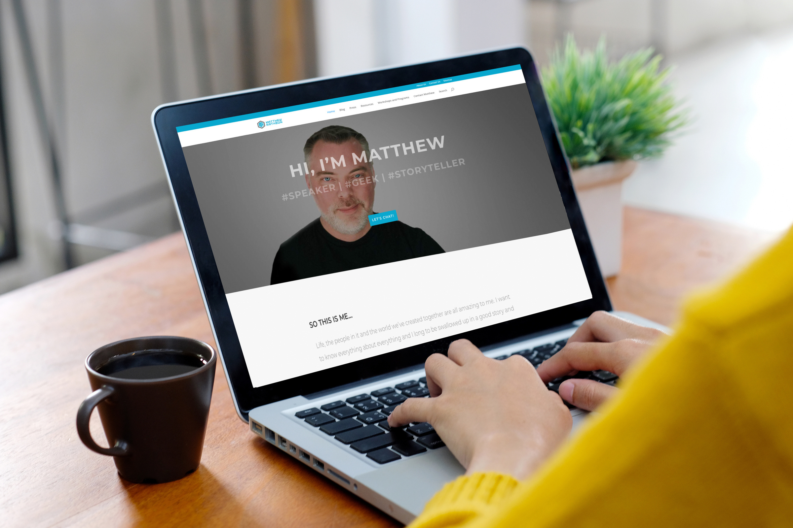
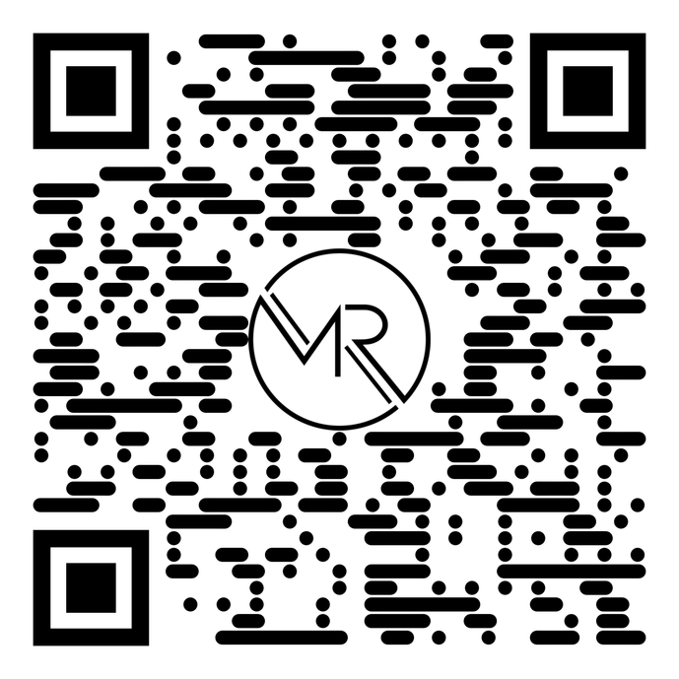
matthewrathbun.com/humans

Slide 4
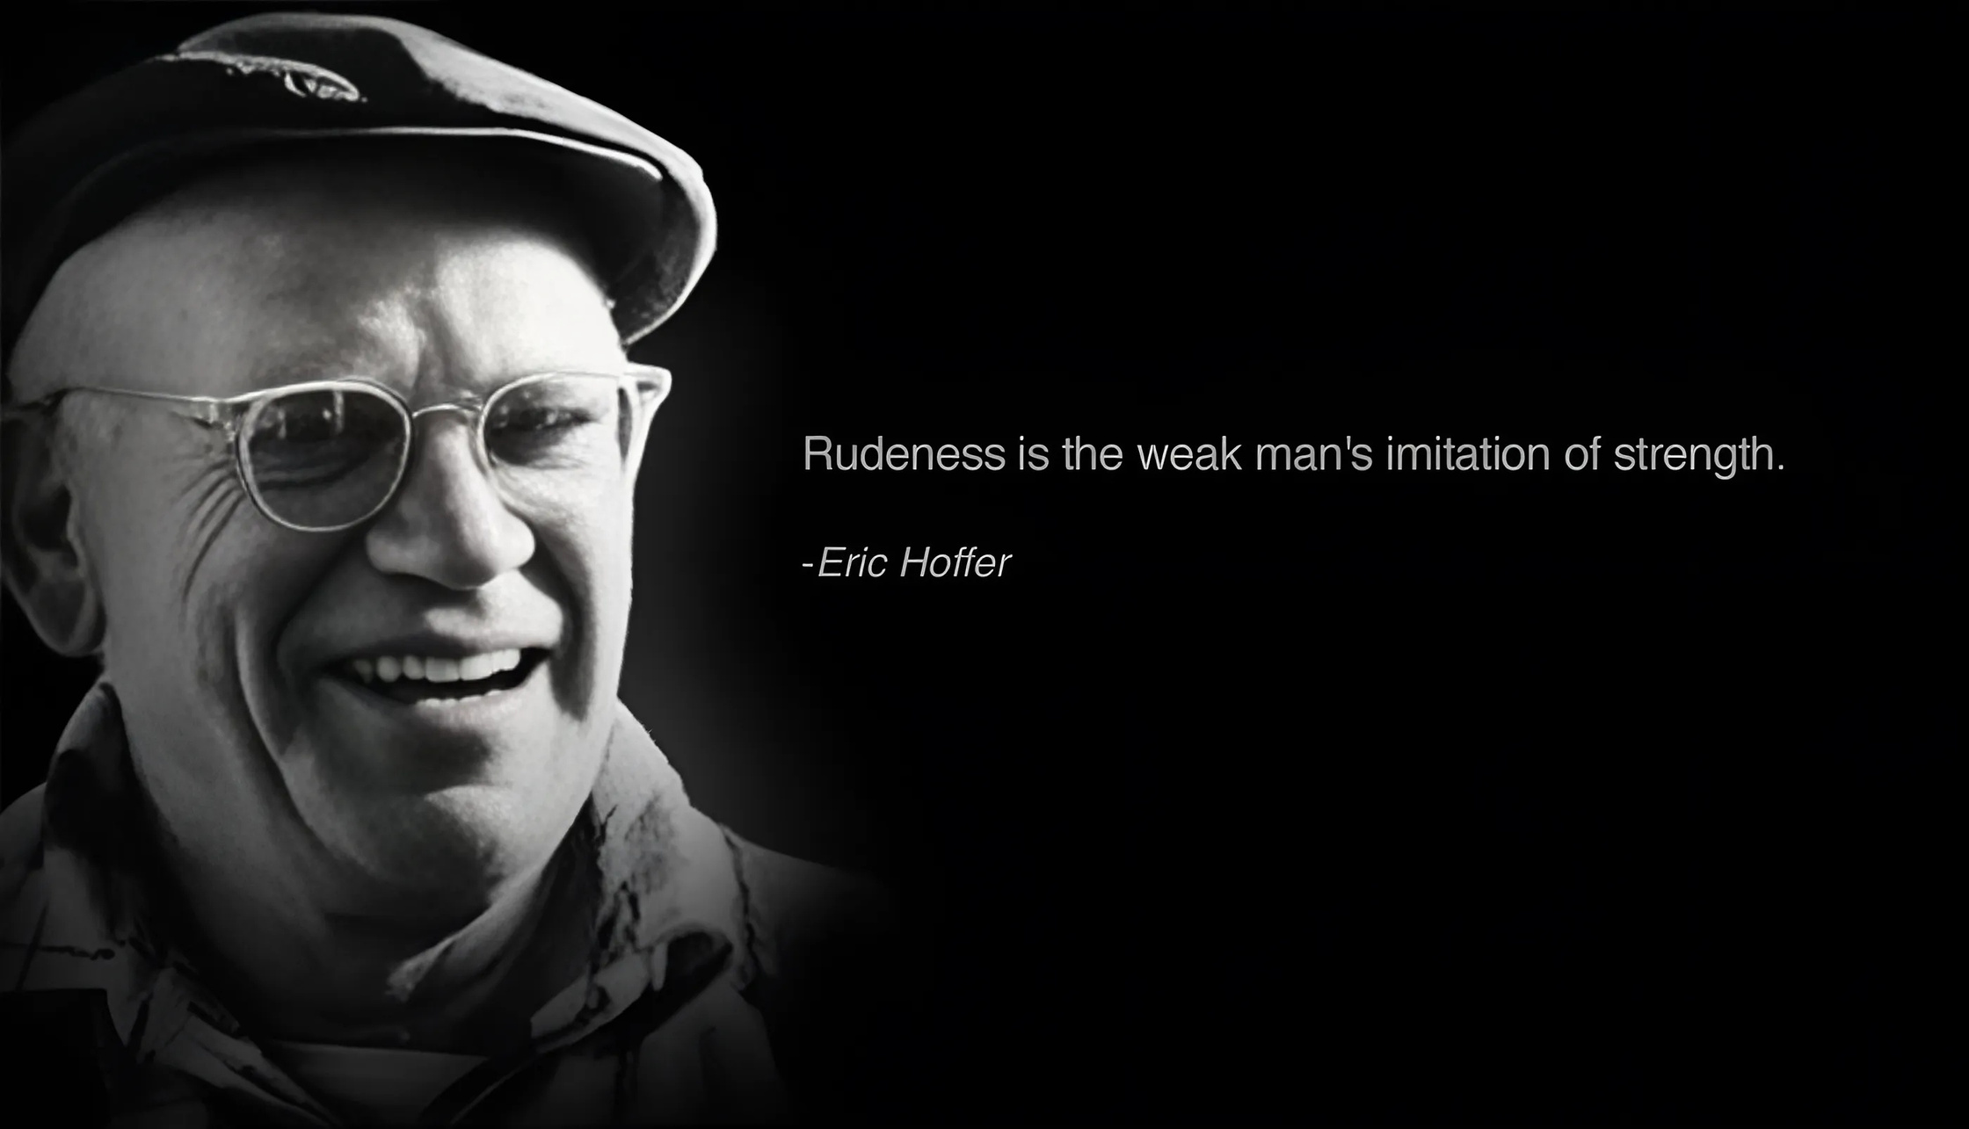
“In times of change, learners inherit the earth, while the learned find themselves beautifully equipped to deal with a world that no longer exists”
Eric Hoffer, Philosopher

Slide 5

the
changing
world
Tech Trends
To Watch

Slide 6
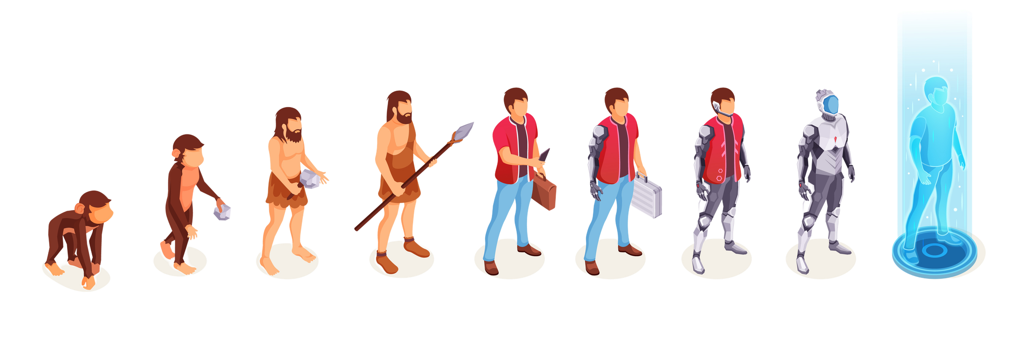
evolution of technology and consumerism

Slide 7
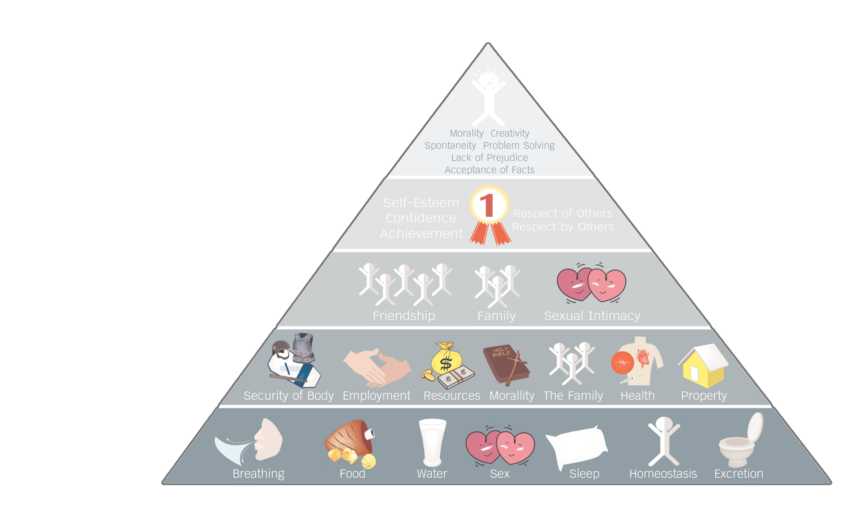
Maslows
hierarchy
of needs
Self
Actualization
Esteem
Belonging
safety
Physiological

Slide 8

We have 70% less human interaction than 10 years ago

Slide 9

we need to reach them where they are

Slide 10

“Share your value”
isn’t nearly enough

Slide 11

Talk To Me
vs
“About Me”

Slide 12

trust is built from experience or emergency

Slide 13

The ERA of misinformation

Slide 14

broken
Trust

Slide 15

1995
2026
$159,000 Average Home Price
$420,000 Average Home Price
$45,000 Average Household Income
$72,000 Average Household Income
6% of income for childcare
18% of income for childcare
18% of income for housing
38% of income for housing
$55,000 was a comfortable living
$220,000 is a comfortable living
91.73% rate of inflation over 30 years

Slide 16

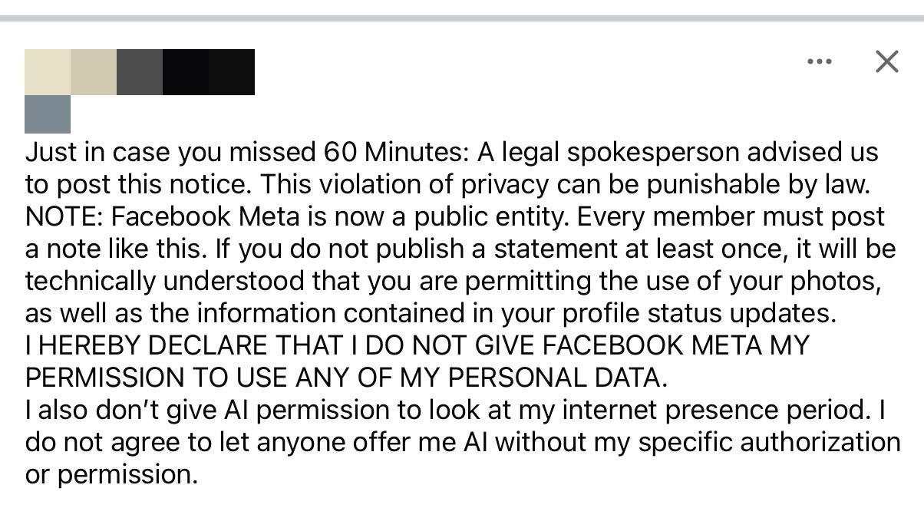

Slide 17

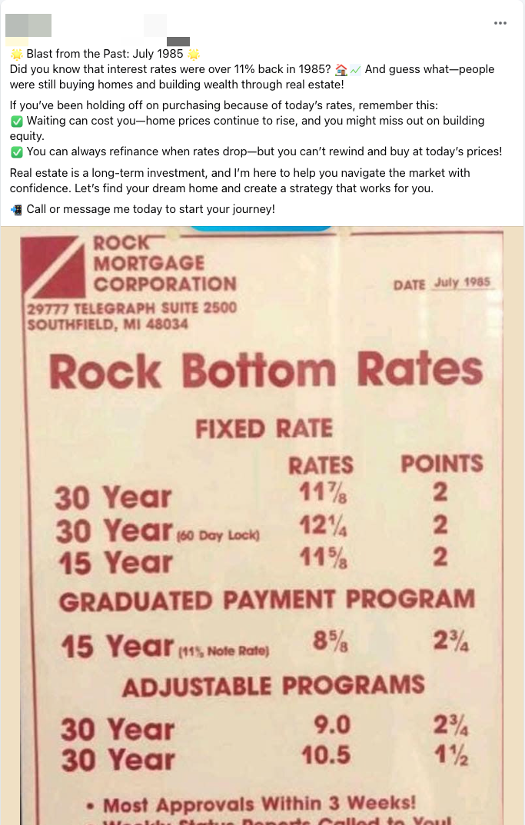

Slide 18
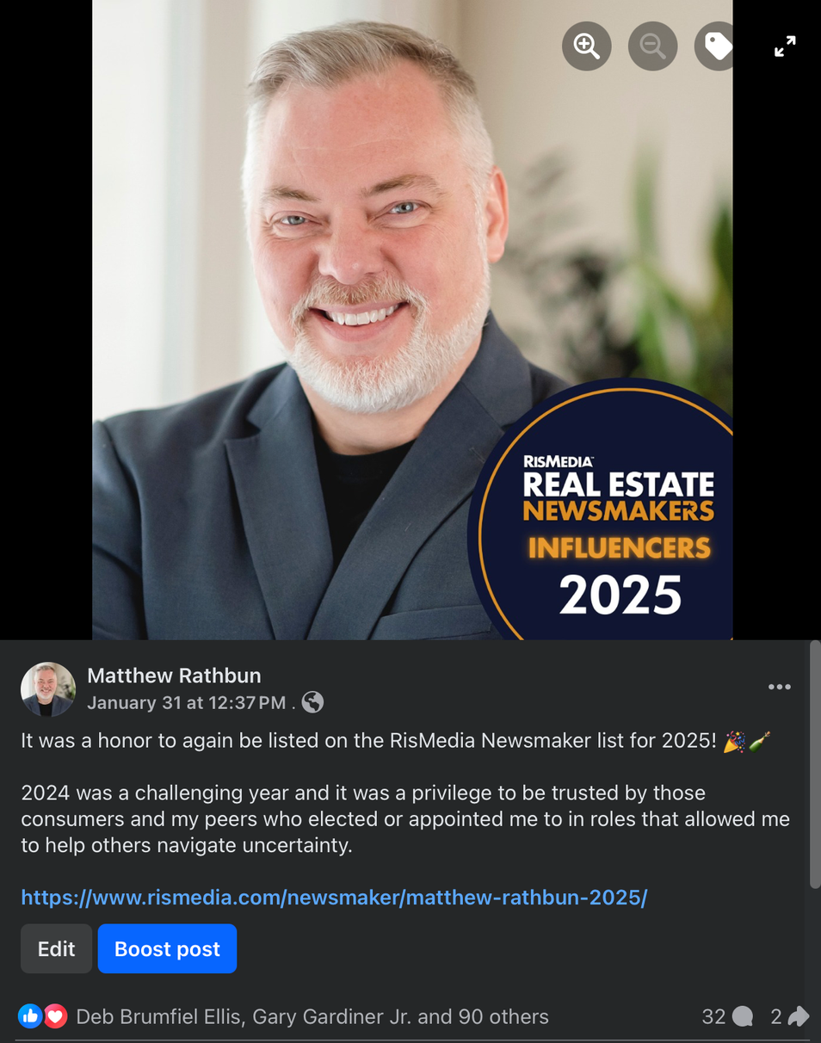
678 likes and 327 Comments
90 likes and 32 Comments

Slide 19
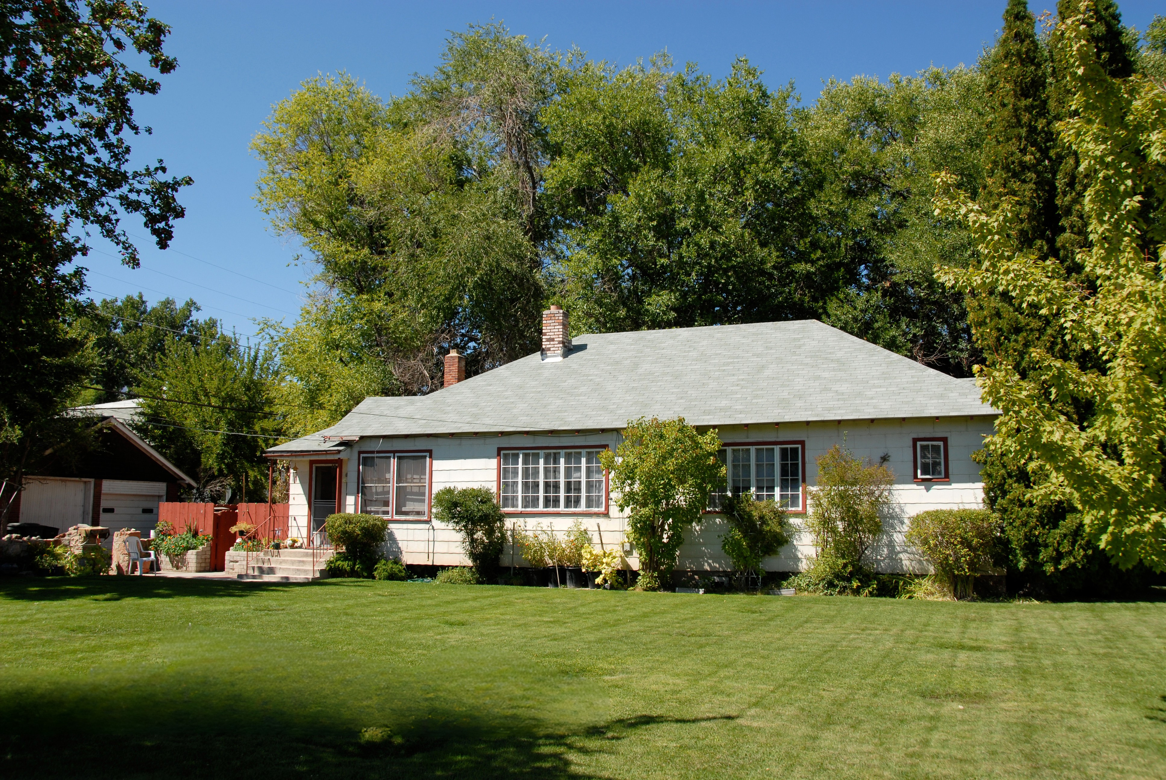
Why does it have to be a “dream home”?

Slide 20

AI EVERYTHING

Slide 21
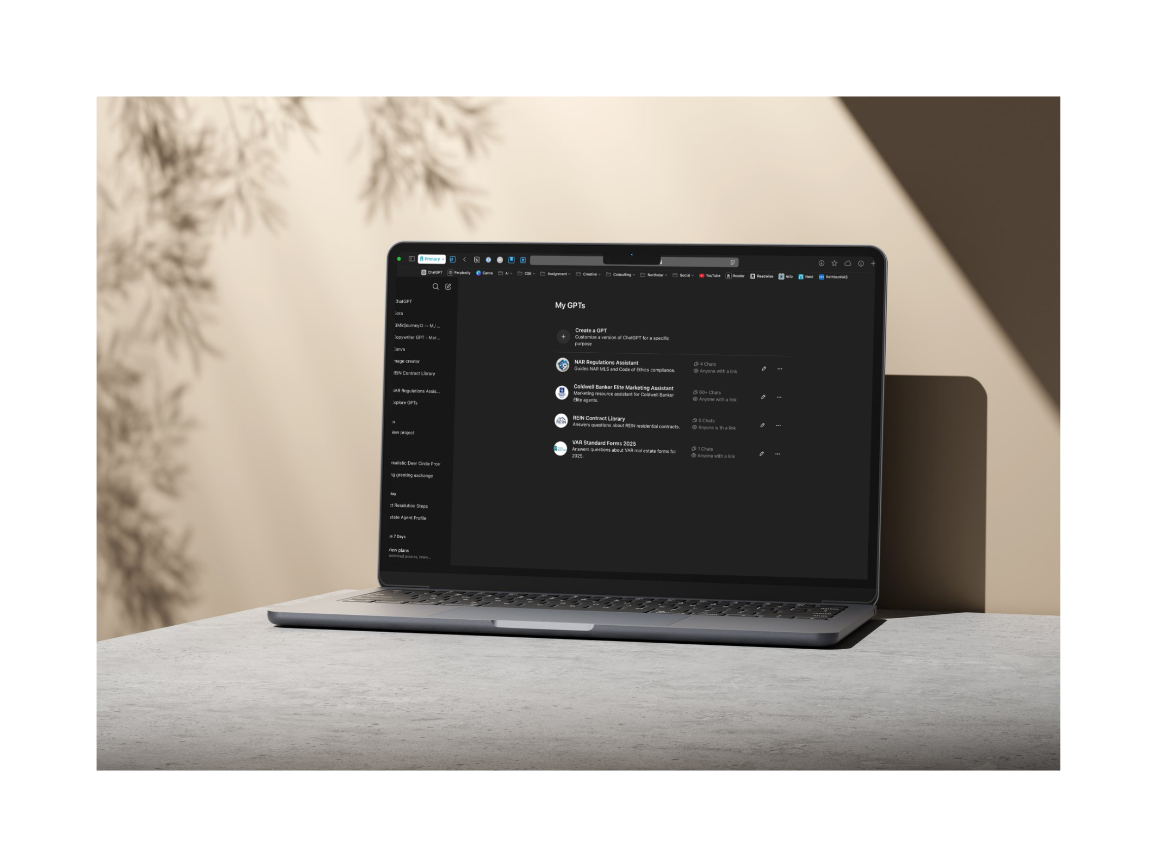
emerging role of ai

Slide 22

AI needs to be married with creativity and humanity

Slide 23

53% reduction in Google use

Slide 24
let’s
get to know them

Slide 25
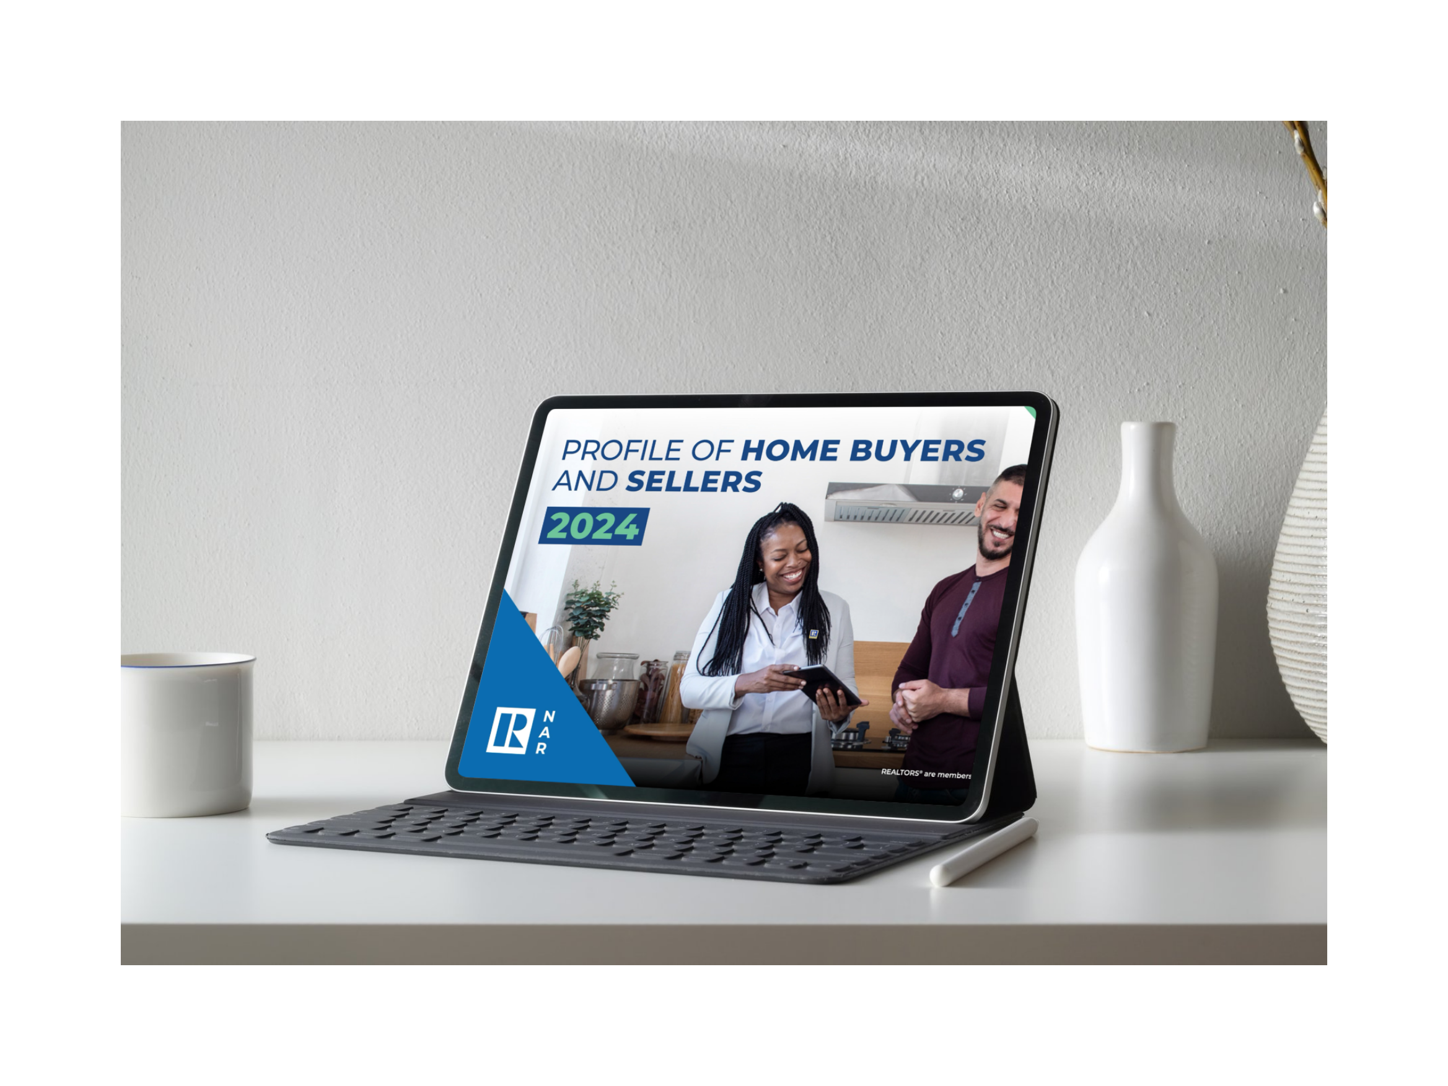

Slide 26

The Opportunity Report

Slide 27
narrpr.com

Slide 28
consumer persona

Slide 29
How are you the solution to the problems they know they have and those they don’t?

Slide 30
The
social media migration

Slide 31

From Connection to indulgence

Slide 32

embracing their echo chambers

Slide 33

social media is borrowed land.
websites are owned real estate.

Slide 34

Breaking through the noise

Slide 35

mastering
their
dopamine
Addiction

Slide 36
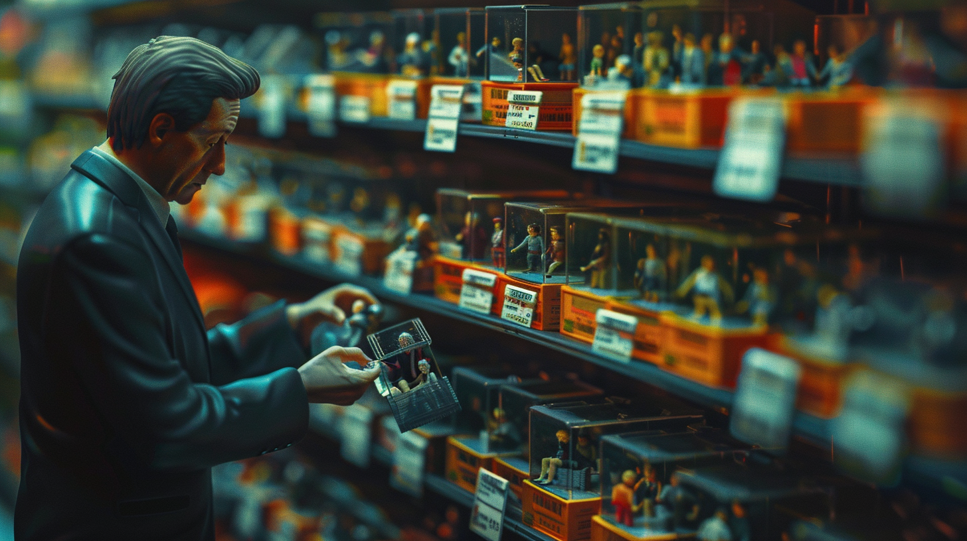
death of
transactional
marketing

Slide 37

more than just a sale

Slide 38

Vision Casting
and
Storytelling

Slide 39
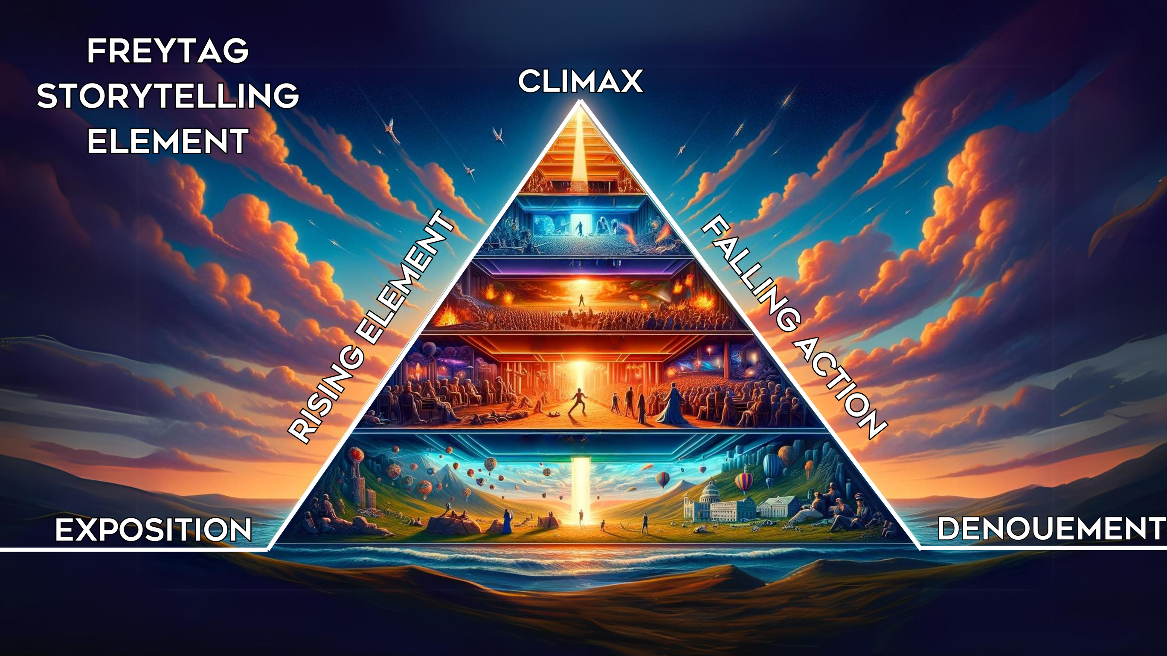

Slide 40

exceptional
experiences

Slide 41

The
unique part
of
a
value prop

Slide 42
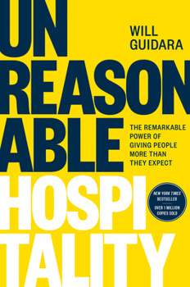
Next Level
Service
  Dreamweavers
    What have you overheard?
  The One-Inch Rule
    The final inch of a long investment
  The 95/5 Rule
    What 5% of your budget or time is dedicated to the “next-level”
  Charitable Assumptions
    Don’t assume disinterest or conflict
  Act “As If” - The Critic’s Table
    What if you were your client?

Slide 43
PersonaliTzion
through
Systems
(not spreadsheets)

Slide 44
AI Augmentation

Slide 45

Using AI to humanize the engagemEnt
  Nurture Sequence
  Automated Lifestyle Content
  Consumer Personas
  CRM Email Series
  Create Field Guides

Slide 46
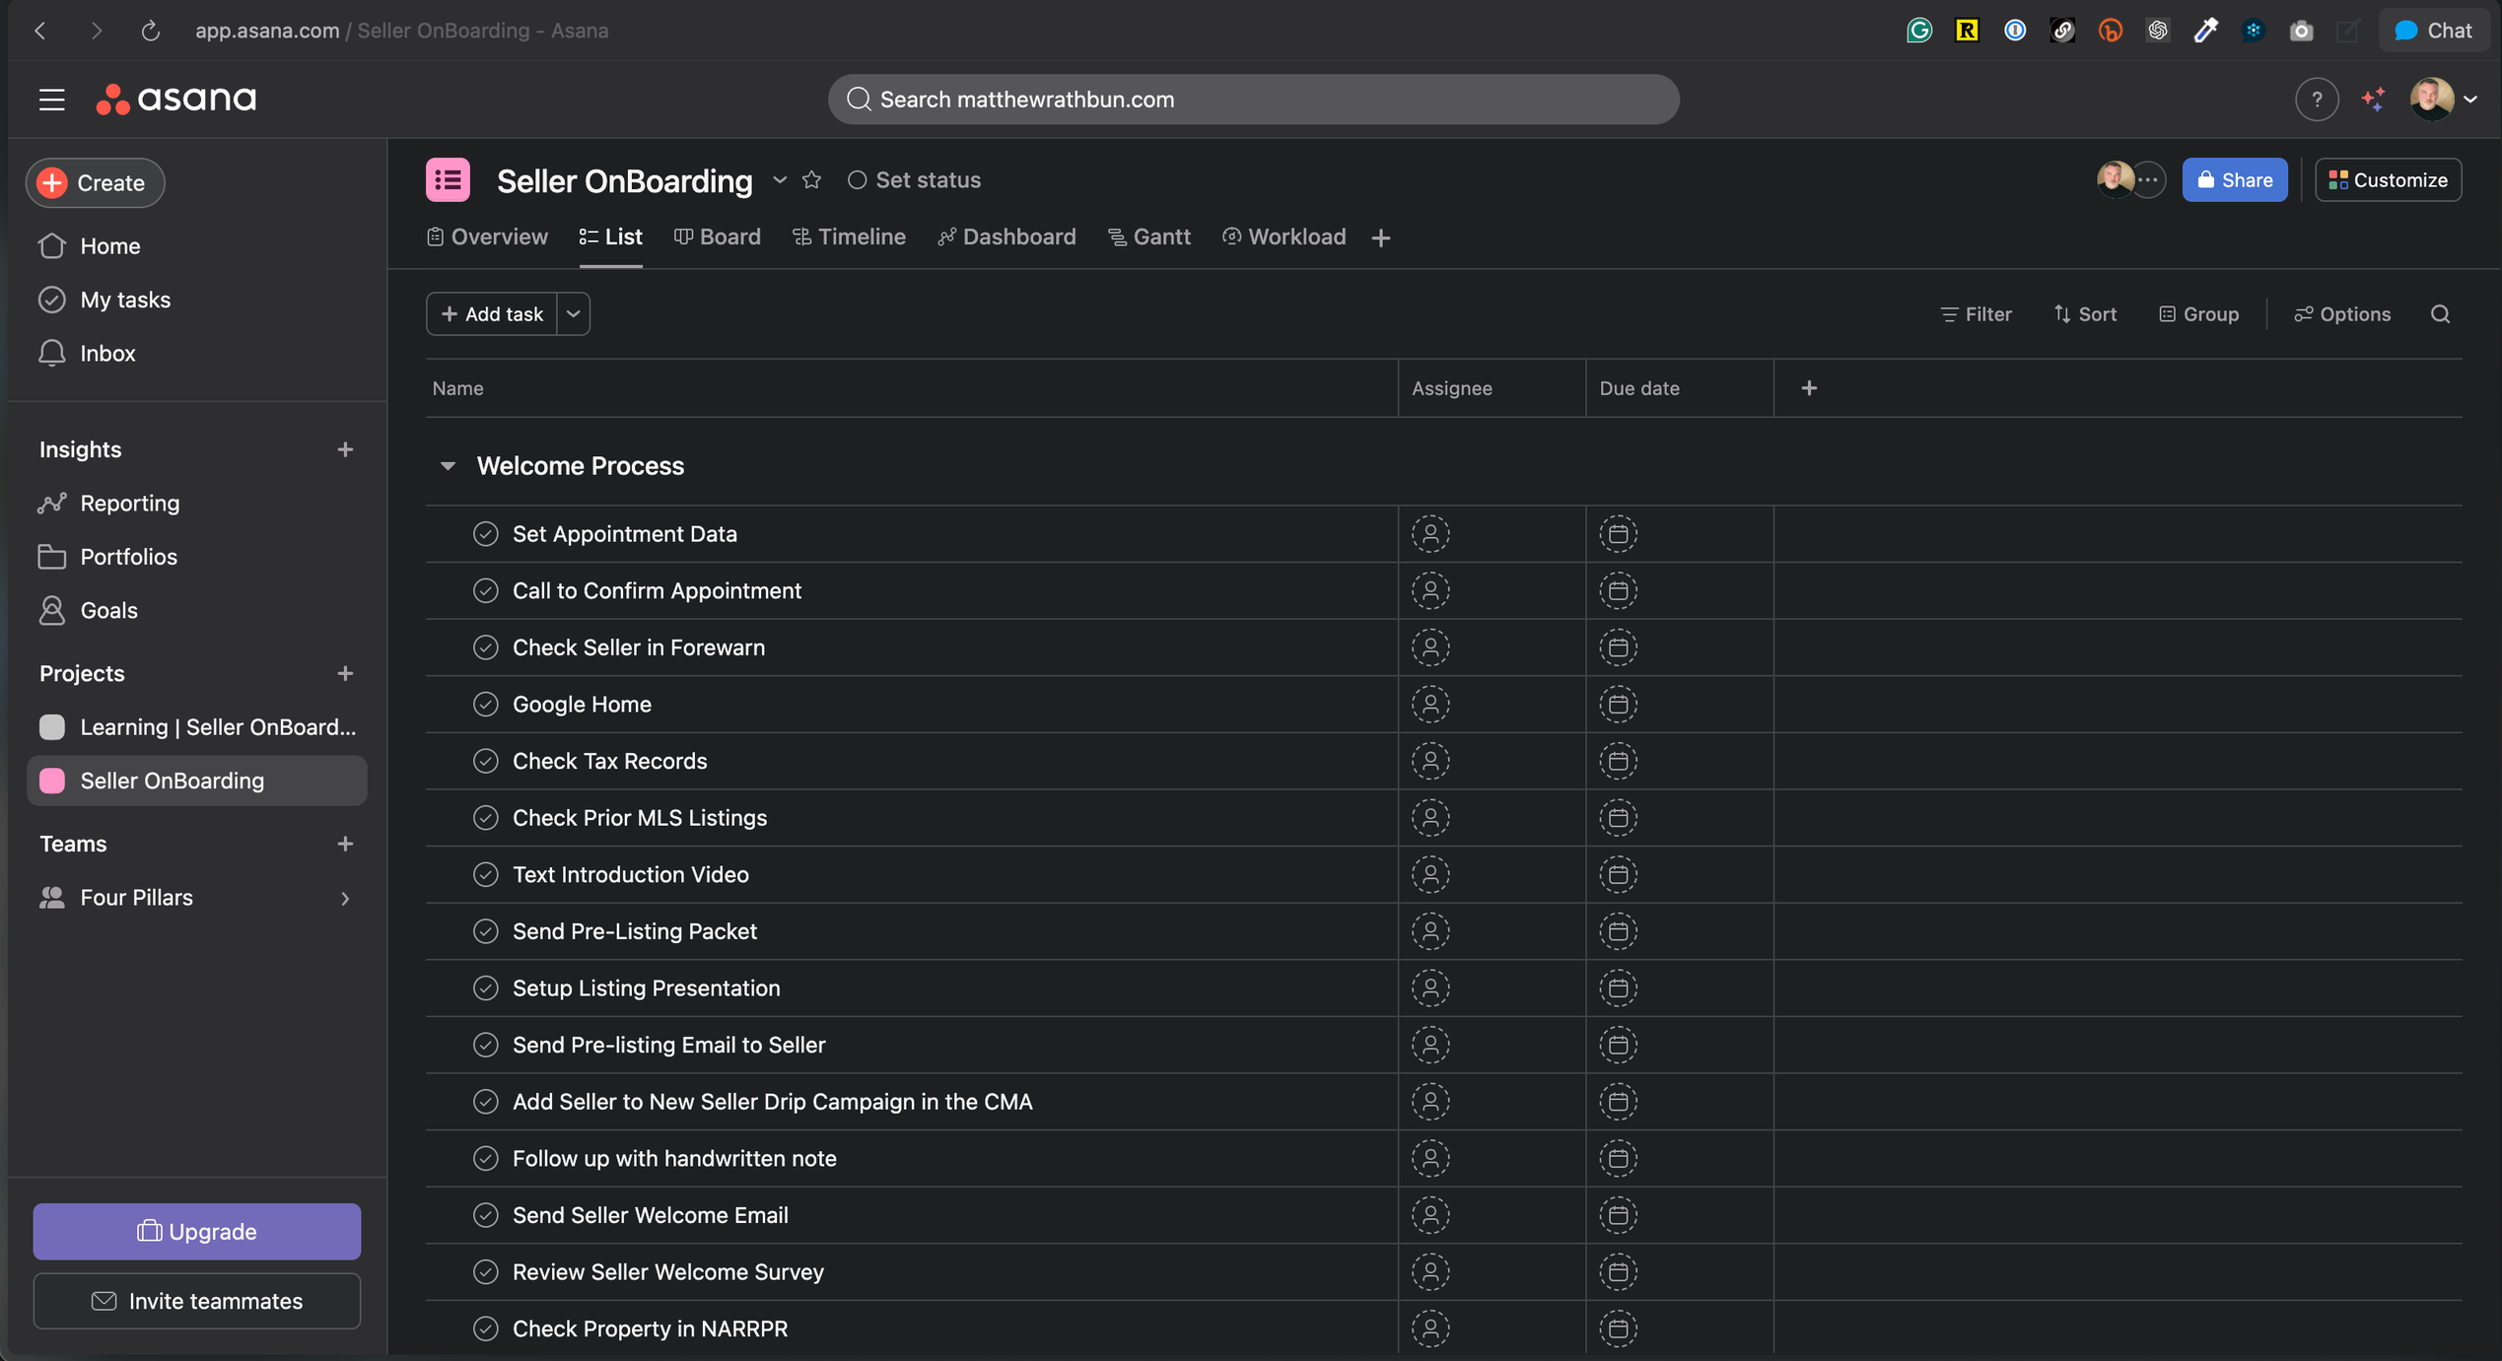
AI Assistants

Slide 47
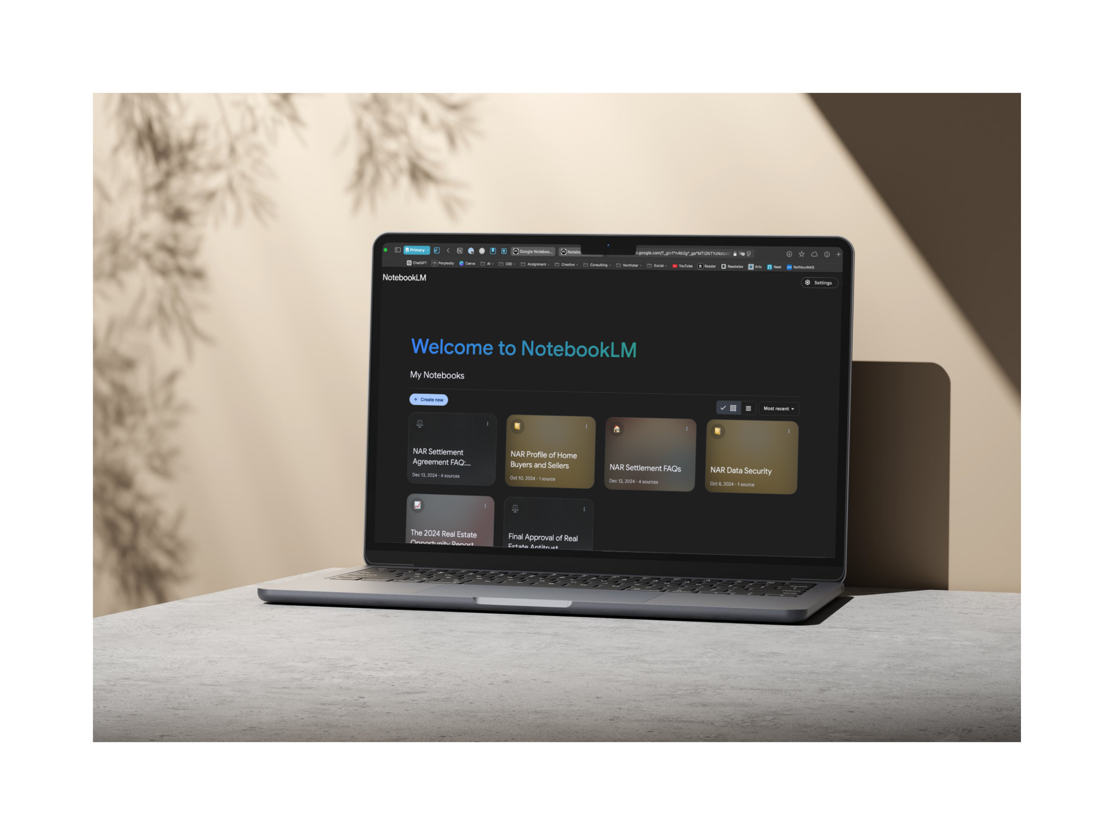
notebooklm.google

Slide 48
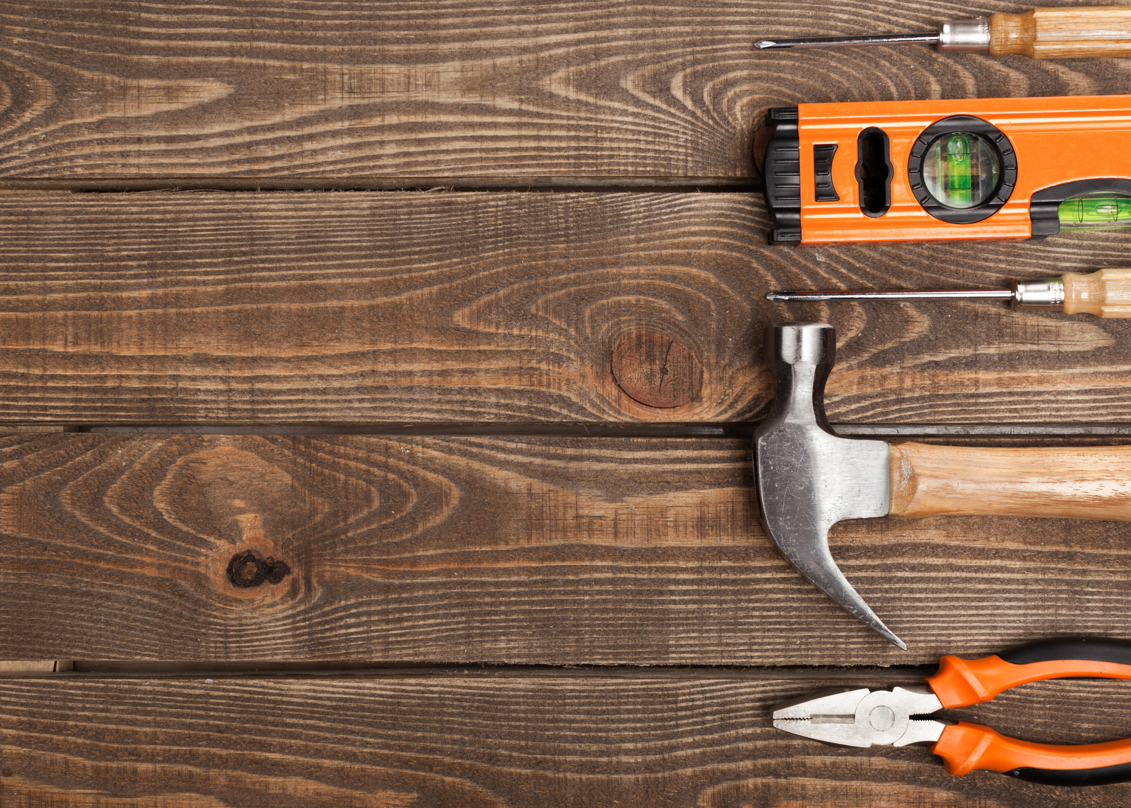
  Personal touches
  polls
  Field guides
  surveys
  videos about life
  Handwritten notes
  Phone calls
  puppies

Slide 49
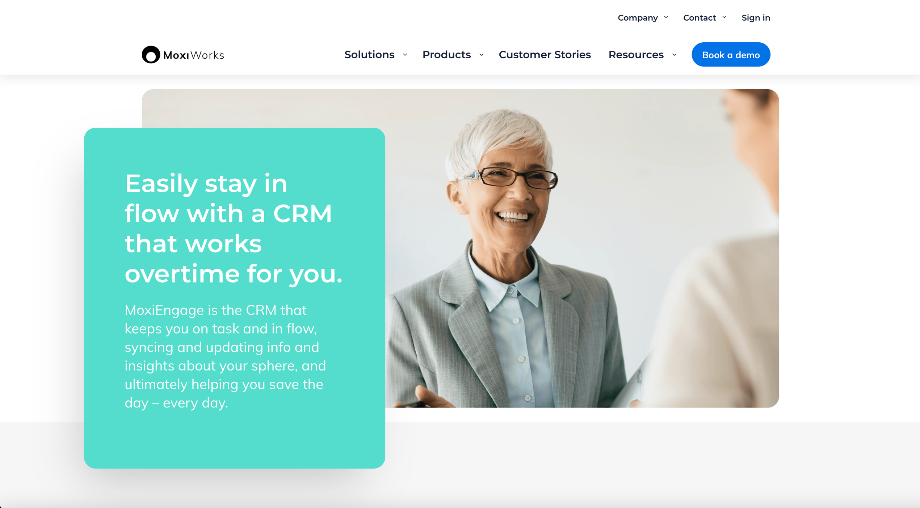
the role of crms

Slide 50

NAR Profile of Home Buyers and Sellers

Slide 51
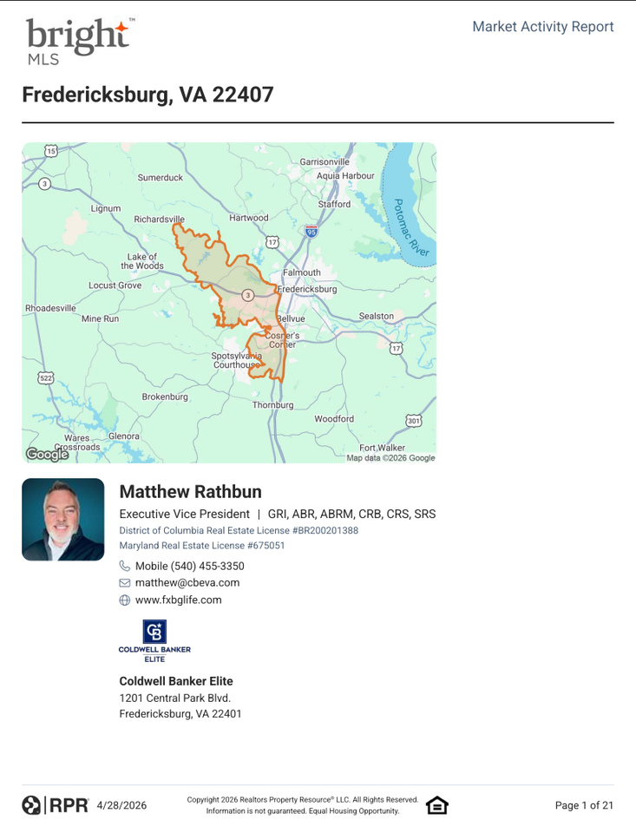
NAR RPR Residential Market Activity Report

Slide 52
People first, process second
Identify the Consumer Persona
Build The Plan and Assets

Slide 53
THE WORKFLOW
From storyboard to asset in minutes.
01
02
03
04
05
06
07
Provide Data
Consumer
Focus
Identify
Resources
Create the Plan
Create Assets
Send to Canva
Deploy
You sketch the idea in plain text.
Outline + personas in.
What tools do you have to work with?
Create a marketing coach
Create things like marketing plans, nurture plans and social assets
Canva produces it in your brand
Start the action sequence

Slide 54

The role of the CRM

Slide 55
  Re-writing and Responding to emails
  Email templates and Onboarding
  CRM Email Campaigns
  Newsletter Content
  Listing Marketing Emails
Emails and
Newsletters

Slide 56
Build The Plan and Assets
  Clear promise at the top
  Segmentation before sequencing
  A rhythm the recipient can predict
  Value that isn't a sales pitch
  A built-in exit ramp to a real conversation
Nuture
Sequence

Slide 57

If you believe that you’re the best guide for them, don’t leave them to anyone else.

Slide 58

your brand is the totality of all they see about you.
be a brand worthy of their trust.

Slide 59
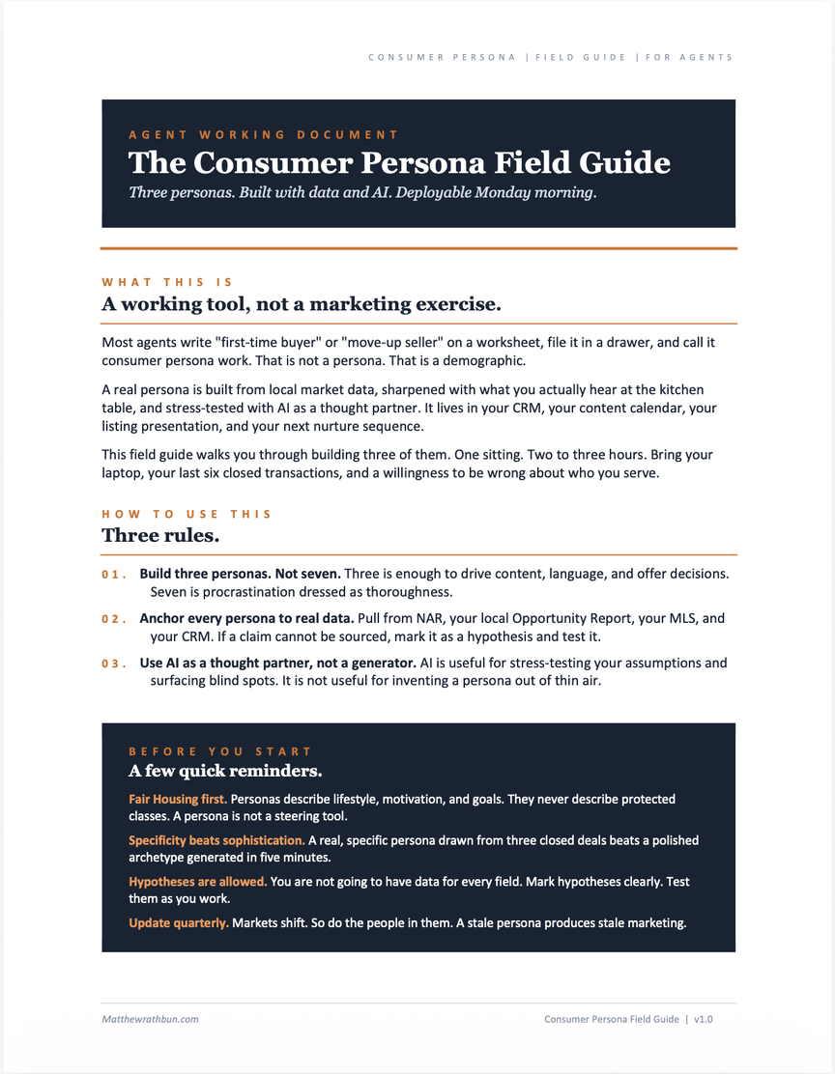
Consumer
Persona
Field Guide

Slide 60
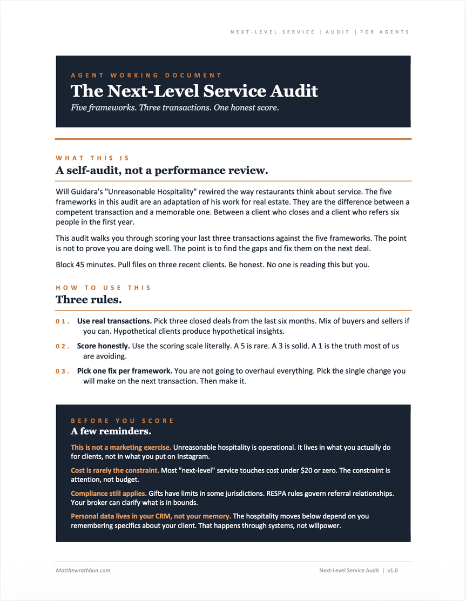
Next Level
Service Audit

Slide 61
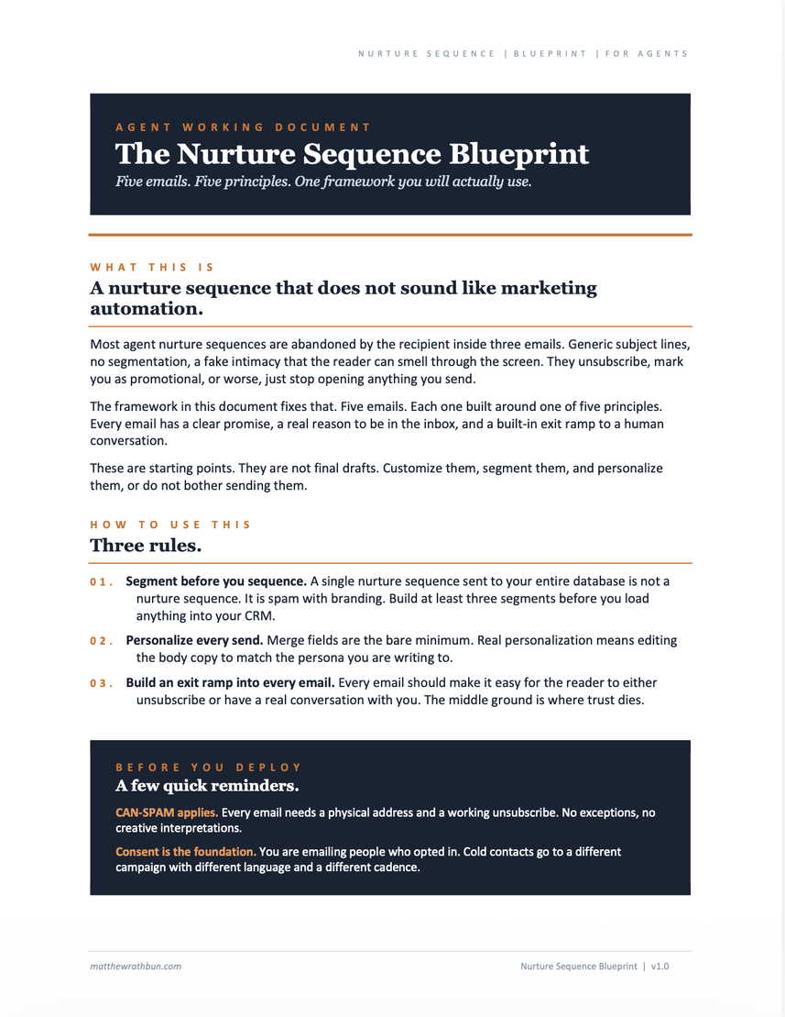
Nurture Sequence
Bluprint

Slide 62
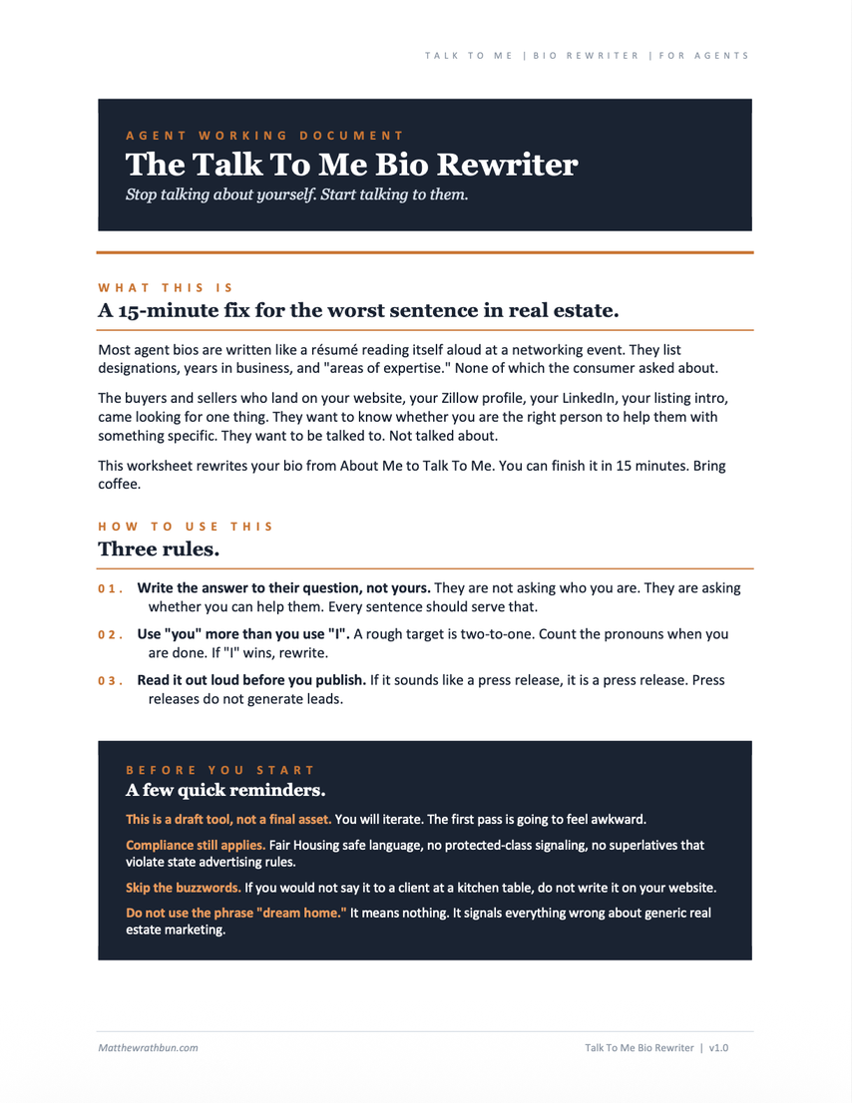
talk To Me
Bio REwriter

Slide 63
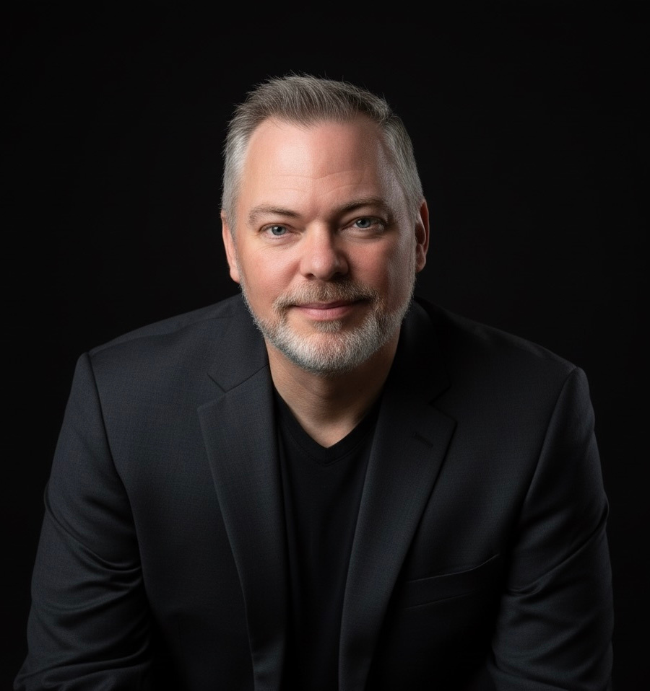


THANK YOU!
matthewrathbun.com
QUESTIONS
AND
ANSWERS

