Slide 1

Curating an Excellent
Client Experience
Austin Southern – Top Producer Takeover – 09/18/2025
Notes:
Good Afternoon!
It’s an honor to be sharing the stage today with so many wonderful and inspiring people in our industry and to be in a room full of committed professionals like yourselves.

Slide 2
Who loves this business?
Notes:
Let me begin by asking… who loves this business?
Who thinks that this is the greatest business in the entire world?
Who thinks it’s a privilege to get up in the morning and help people with one of the things most crucial to their lives?
What other business gives you an excuse and an opportunity to go out there and make a bunch of friends while getting paid to do so?

Slide 3
Gratitude – Service – Relationships
Notes:
I’m grateful not only to have breath in my lungs as I stand before you today but to be in the business of real estate.

Slide 4


Who am I?
Managing Partner, Monumental Powered by PLACE
Year 6 in Real Estate Sales, decade in Entrepreneurship
Nothing to sell you – Only what works
Tom Ferry 30 Under 30 Honoree
Notes:
Many of you don’t know who I am and I’d like to give you a little background and context as to why you might be interested in what I have to say today. Bear with me for a few minutes here.
I am Austin Southern the Managing Partner of Monumental Powered by PLACE and I have nothing to sell you.
I am in my sixth year of the real estate sales business and in my 10th year of being in business for myself.

Slide 5
Lessons Before Real Estate
Started in retail in Richmond, VA
Earned little, learned a lot
More lessons from my PPC agency
My pandemic reset
Notes:
Prior to real estate I put my economics degree on hold and opened a retail store in the Richmond area. I was terrible at business, had no idea what I was doing, burned a lot of bridges, made some friends, lost some more, and ultimately lost time and money but gained invaluable experience and an understanding of the grit necessary to start from the ground up.
After that I spent some time working for a variety of small businesses selling services around Pay-Per-Click Ads. I learned equally many lessons in this business. We served too many customers, too broadly. We didn’t specialize in any one thing that we were the best in the world at. We weren’t able to punch up to the caliber of client that would have prevented us from being fired by absolutely everyone on our client list when the pandemic came and closed everything in March of 2020.
It was a crossroad in my life. I wasn’t sure what direction I would go next. I had just been licensed as a real estate agent because we were heading the direction of serving agents in my Google Ads business.
Here I am with a fresh real estate license in hand (which during COVID took 45 business days for the board to process) no in-person meetings, no book of business, no real estate specific knowledge, and some rough sales skills.

Slide 6
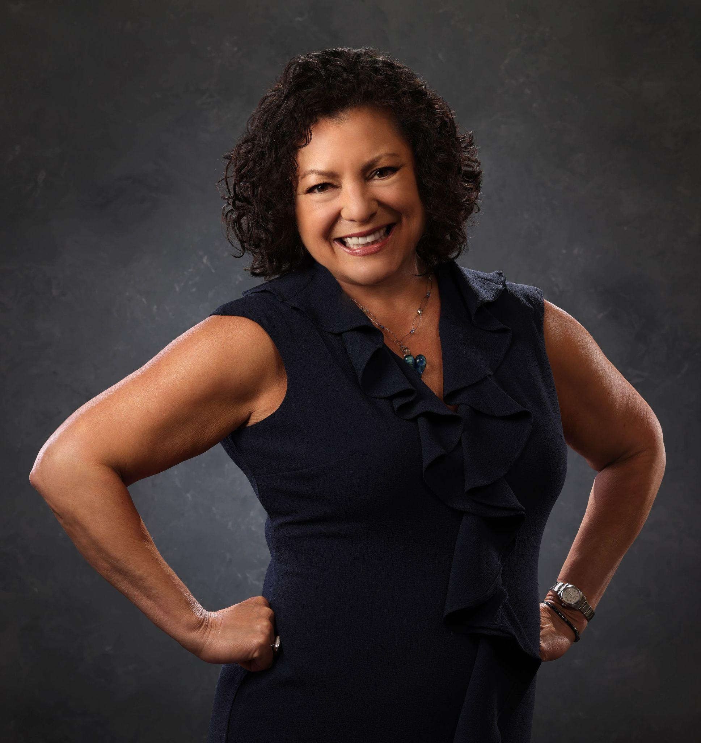
My Mentor: Roxanne Southern
Notes:
I called her up while I still lived a few hours away and said, “what if I moved into an apartment in Arlington and we got into business together”
Now mom is an excellent agent and always has been. She cares deeply for her clients, she’ll work tirelessly to get a deal done, she’ll draw on experience and stand on the shoulders of great mentors like Mike Briggs here at Samson.
In fact, she started at Samson in 2005 as a full-time agent.
Up until 2020 she had some good years and some not so good years and ultimately never made more than about $185k in gross commissions in those first 15 years.
Joining forces, focusing on serving our clients well, building repeatable and duplicatable systems, scaling the unscalable work that builds relationships…

Slide 7
“Down Market”
Notes:
Together, this summer, in a “down market” from June 1st to August 31st we made $463,724 in gross commissions at a very healthy profit margin and the next three months look even better.
I look back on this and I ask myself what makes the difference? And the answer always comes back to making a difference in our clients lives.

Slide 8



A new WHY
“How can I make a difference in the lives of people I serve?”
Notes:
So, I’m on a mission.
And to you present in the audience, I would like to ask you to come with me on this mission.
I asked a few moments ago “who loves this business?”
I want that answer to be every hand in the room.
We all get into this business for different reasons. Among the most commonly listed are: “I want to be my own boss”, “I want freedom of my time”, “I want financial freedom”, “I don’t want to be chained to a desk”.
We all have an original “why” that got us on this real estate track. I’m here to make an argument before you today for a new “why” that can come right alongside all the others.
What if the mindset shift of the industry was: “How can I make a difference in the lives of the people that I serve?”
What if your internal dialogue shifted to “I get to wake up in the morning and use my unique set of skills, personality, and creativity to craft an experience for my clients that is unforgettable.”
“I get the opportunity to make pro-athlete money and the measuring stick for how well I do is how many people I impact”

Slide 9
Stalwart (def.): a loyal, reliable, and hardworking supporter or participant in an organization or team
Notes:
A couple of years ago I had the privilege to be in the audience when a great man and a great mentor to many of us spoke to a few thousand of us Realtors.
David Childers? I know you’re in the room somewhere.
A man known to many as “The Oracle”, the late, great Steve Harney once said it was an honor to be speaking to a room that room of Realtors because no matter what area, no matter what price point, we are people that serve our communities. We are people that care about our communities. And the word he used was “Stalwart”.
Meaning someone who is a long-standing, reliable, and strongly supportive member of the community—someone others count on because they consistently show up, help out, and uphold the community’s values.
If we all embodied that, there would never be a question as to a Realtor’s value.

Slide 10
Today’s Takeaways
What you’ll walk away with
Basics and prerequisites
Examples of when small gestures made all the difference
Strategies that can help us build one of a kind experiences for our clients
The skills necessary to execute
How to build a client experience “tool” for yourself
Notes:
What you’ll walk away with…
Today we’re going to review some basics, prerequisites for bringing extraordinary value to our clients.
I’m going to review some examples of times when small gestures made all the difference in a transaction.
We’re going to review some strategies that can help us build a one of one experience for our clients.
I’m going to go over the skills necessary to execute these strategies.
And finally I’m going to show you how to build the ultimate client experience tool for yourselves, so have your notes ready.

Slide 11
Prerequisites
We need to hold ourselves to a higher standard
Your personal WHY
Your new WHY
Your mantra
True professionalism
We’re hard on standards not on people
Notes:
We’ve covered the first prerequisite… “WHY”
Our personal why’s might include reasons only familiar to us: I want to give me family the life they deserve. I want to drive certain cars and live in certain houses and vacation certain places. I want to be the very best there ever was. I want to buy X number of doors so that I never have to attend a listing appointment again as long as I live.
Alongside our personal “why” is the mantra that needs to be backing all of our actions from here forward is that “client experience is at the forefront of what I do”.
The next is your commitment to being a true professional Realtor. Mistakes, inaccuracies, preventable problems, all of these will detract from your client experience and no amount of making the client feel special can change this. The only way to elevate your business is to have high standards for the fundamentals of your business.

Slide 12
Client Relationship Management (CRM)
(def.) THE most useful tool in your business.
Notes:
And in that vein of fundamentals…
There is one key area that every sales role requires and it is no different in real estate. You need a Customer Relationship Management system (CRM) and you need to use it like it is the lifeblood of your business.
If you are in a place in your business where you don’t feel near capacity it may feel easy to stay on top of your clients through your texts, emails, and calls.
There will come a time, when your business has grown, and you are keeping up with tons of prospects and dozens of current clients that things will fall the cracks. You will miss something. The CRM exists as the antidote to this. If you don’t have one, you need to use what’s available to you. I don’t care if it’s just a well-organized excel spreadsheet. You need a CRM.

Slide 13
Active Listening
A skill above all else
Full presence
Non-verbal cues
Verbal cues
Reflecting
Questioning
Non-Judgemental Stance
Why?
Build Trust and Connection
Improve Communication
Resolve Conflicts
Enhance Empathy
Notes:
Hand in hand with the CRM is the most crucial prerequisite skill that you need to employ…
Active listening.
Key Components of Active Listening
Full Presence: Be fully present and focused, avoiding distractions like phones or formulating your own response while the other person is speaking.
Nonverbal Cues: Use nonverbal signals like maintaining eye contact, leaning in, and nodding to show you are engaged and interested.
Verbal Cues: Use brief verbal acknowledgments like "I see" or "uh-huh" to show you're following along.
Reflecting: Paraphrase or summarize what the speaker has said using your own words to confirm understanding.
Questioning: Ask open-ended, clarifying questions to gain a deeper understanding of the speaker's thoughts and feelings.
Non-Judgmental Stance: Set aside personal biases and judgments to fully understand the speaker's perspective, regardless of whether you agree with it.
Why Active Listening is Important
Builds Trust and Connection: By showing you care and understand, you build stronger relationships and create an environment where open communication can flourish.
Improves Communication: It ensures messages are accurately understood, preventing misunderstandings and promoting more meaningful conversations.
Resolves Conflicts: By allowing both parties to feel heard and understood, active listening can help de-escalate and resolve conflicts effectively.
Enhances Empathy: It helps you step into another person's shoes, fostering deeper empathy and emotional intelligence.
And finally, for our purposes today, it is most important to hear those subtle unique opportunities where you can shine as a real estate agent.
In every client interaction from the phone call that you make to set your first appointment to a follow-up years after a transaction, your client will share details about their life that you can use to tailor their experience, surprise them with gifts that connect on a personal level, and differentiate yourself.
These must make it into your CRM notes – If it isn’t in the CRM, if we can’t recall it, it doesn’t exist.

Slide 14
Niching = Friction Removal
The riches are in the niches
Avatar = Predictable Pain Points
First-time buyers = “Open-First” Kit
Downsizing Seniors = Large-Print Timelines
Notes:
Nicheing
An overlooked starting point for curating your business and services around your clients is nicheing down to serving a specific avatar.
There are dozens of prototypical avatars that come with their own unique set of problems and you can construct your processes and your standard operating procedures around these unique sets of problems.
First time homebuyers, for example, have never purchased a home before and are overwhelmed by the process. They’re not thinking about the small things that might be needed once they get the keys. Imagine their surprise when they get to their new home and the bathrooms are stocked hand soap and toilet paper and on the counter is a bucket with travel size dish soap, sponge, disposable cutlery and utensils, some laundry detergent, a small set of hanging fasteners and a miniature tool set, and all of those things that are packed away and buried in their move. You have met them where they are, you thought of things that they aren’t in the sea of overwhelm of new homeownership, and their Realtor just delivered something to they didn’t even know they needed.
Downsizing seniors, another niche that has a lot of opportunities for high touch service. For them, bring as much as you can back into the physical world. Digital portals may not connect like they would with other clients. Focus on information heavy deliverables, spelling out the process step by step (because they often haven’t moved in just as long as first time homebuyers), and commemorate each milestone by getting out a nice pen, some branded stationery, and writing them a heartfelt note thanking them for their trust in you when you take the listing, when you sell the house, and just to say hello occasionally.
Think about every part of your process for your clients in general and especially the niche you choose to serve. Figure out where the pain points are early and often and think about how you can remove friction at every step. Let’s dive into some more concrete examples.

Slide 15
3 Client Stories
01
02
03
Parisian Tea
Diet Coke Extravaganza
It’s not about Golf
Notes:
Parisian Tea
For the first we’ll use a very small example that went very far in my business. I attended a listing appointment and during that appointment I gained some crucial information. I noticed our future client drinking tea and not only tea but loose leaf tea from France. As our conversation progressed I listened to our future client fill me in on her life story and that for 7 years she lived in the 4th arrondissement of Paris. This also just so happens to be home to the headquarters of Mariage Freres a Parisian luxury tea house. Matching the eclectic and bold personality of my client I chose their flavor Marco Polo which features decadent and abundant florals. This tin of loose leaf tea showed up at her house the very afternoon following my morning appointment via courier. The email I received was one of ecstatic joy at just how perfect the small gift of tea and a handwritten note were. We didn’t know it at the time but we were in for a very difficult transaction with this client but built on a foundation of listening and showing up where it matters, my value was never in question.
Diet Coke Fridge
The next is a story of soft drinks (funny I didn’t think that drinks would be a theme here, but I’m sensing a pattern). During the height of pandemic competition amongst buyers I worked with a couple who were not very optimistic about the possibility of homeownership. We had lost a few offers as was much more common in those days, toured dozens and dozens of houses over the course of several, several months. Every time I saw this couple in one form or another the wife had a diet coke with her. Whether it was a can, a bottle, the fountain variety from the Sunoco down the street from where we were touring houses. She described it as her one vice in life that she would never give up after giving up smoking, sugar, and everything in between years prior. After our long tenure together as Realtor and clients we finally win their perfect house. Not only did they win, which was a huge victory a few short years ago but it checked every single box they wanted to check. It had the screened-in porch the husband wanted, it had the playground equipment that the kids wanted, it had the home office with built-in’s that the wife wanted. They were absolutely thrilled. That excitement was NOTHING compared to the excitement when they got they keys after settlement. In the built-ins in her office there was an outlet and just the right amount of space to do something… awesome. A short trip to The Everything Store .com and I became the proud new owner of a Diet Coke themed mini refrigerator. That fridge was there, plugged in and full of cold cans of diet coke personalized from Coca-Cola’s website with the buyer's name on them. The screaming joy on the other side of the phone outshone winning the house by a factor of 100. Like the crack of a bat hitting a homerun; that one felt good.
Golf Balls to Solve them All
This last one is a really strange one with some tough emotions attached to it. I had a client which was a buy/sell senior downsizer. He and his wife lived alone in a house with steep staircases and many of them and it was time to leave for somewhere safer. The wife had progressed into the moderate stages of dementia and the husband was her caretaker full-time. Well, the husband did have some aides come by on occasion to give him some freedom to do what he loved to do most, golf. Without aides present he had no way of leaving the house so he was often tied to the property. We were working through some of the items on his home sale one evening and he mentioned he was going to the club in the morning to play golf but he was really frustrated. In an act that really solidified for him his wife’s decline he realized that she had thrown out his supply of golf balls from the garage along with a bunch of other less important things. Some of the frustration was coming to grips with the mortality of his ageing spouse and himself but more of the frustration had to do with the fact that they were special golf balls built for his slower swing in his 80s called Bridgestone Tour B RXS’s. They’re not particularly hard to come by but the club pro shop did not sell them. It was summer and his tee time was early so there would be no way to go to a golf store before meeting his friends and he was stuck at home that evening. This was every opportunity to take some initiative. Hanging off his door knob that very evening was a box of 12 Bridgestone Golf Tour B RXS’s for his outing in the AM. I know that easing the pain of watching your spouse decline is nearly impossible, but we can solve the solvable things for our clients, in this case for $35.

Slide 16
“Getting to know YOU”
Never ask demographic information :)
Communication preferences
Tastes/Allergies
Comforts/Style
Boundaries
Celebrations
Notes:
There are some tools we can use to make these One of One special experiences more common in our business. Sometimes we need a creative boost to really stand out. This suggestion may seem boring but I can’t tell you how effective it is. Create a Google Form, JotForm, Microsoft Form, whatever you have access to with a short questionnaire. Call it “Getting to know you” and send it to your clients. Although they deny it, people love talking about themselves and this is an opportunity to do just that. You can ask questions like:
Beverages (wink, nod)
Sports Teams
Charities
Organizations of Clubs
Restaurants
Shopping habits
Design preferences
Anniversaries
Ask the questions in a way that prompts context. For example: don’t ask “when is your anniversary” not everyone is married and that’s not a happy day for everyone. Ask what special dates are coming up and what’s your favorite thing about celebrating?
Have these responses store in a Google Form or spreadsheet, transfer the relevant information to the fields in your CRM and hold on to this for dear life. These are the small preferences that can make all the difference in how we serve, how we gift, etc. And can be very useful in our final segment here…

Slide 17
AI + You = More Ideas
01
02
03
Have AI create Training Material for you
On the next slide you’ll see a sample prompt to create training material
Create a “project” and utilize your training material
You can use the guardrails and guidelines you create to train your project
Use your client data and put your project to work
Take your form responses and CRM notes and start discussing experience curation.
Notes:
Utilizing AI to gift and curate client experience
I don’t have a custom GPT to share with you today that captures your information and gives me the opportunity to sell you something later on. I’m instead going to give you a few steps with ChatGPT to make your life easier, fair enough?
Okay there are some things that need to be true for this to work. You need to have excellent CRM notes on your clients and you need to implement the “getting to know you form” or be able to write a paragraph on your clients preferences to use with AI.
Next, Ask ChatGPT to Create Material to Train a Project
Copy/paste this into ChatGPT to generate your training instructions:
Prompt:
“Write me a system prompt to train a ChatGPT project called Client Experience. It should:
– Take CRM notes and questionnaire answers as inputs.
– Generate a client snapshot, hospitality ‘moments,’ gift options across 3 budget tiers, an operations checklist, and a compliance risk scan.
– Follow principles from Unreasonable Hospitality and Giftology.
– Enforce guardrails: no demographic descriptors, no Fair Housing violations, no RESPA referral gifts, no logos.
– Style: friendly, specific, and actionable.”
Then you’ll create a project inside ChatGPT and use the results of your prompt above to train the project on your guardrails and specifications.
And finally, Upload Client Insights Per Client & Get Creative
For each new client, paste in their CRM notes + questionnaire answers.
Ask the GPT: “Create 5 hospitality moments and 6 gift ideas within a $600 budget. Show a playful version, a refined version, and an outdoorsy version. Include a risk scan.”
Use the results as your brainstorming base, then personalize and execute.

Slide 18
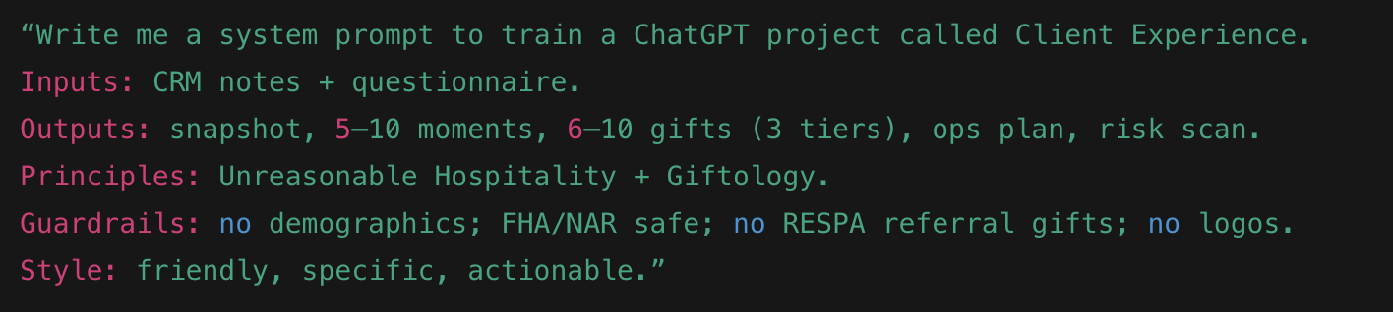
Your sample prompt

Slide 19

What I hope you take with you
WHY
LISTEN
A renewed why centered on service
Active listening and CRM discipline
IDEAS
AI
Small, one-of-one touches beat big budgets
A simple AI workflow to scale hospitality
Notes:
If you leave here with anything I hope it’s these few things…
A new excitement and gratitude for this wonderful business we get the opportunity to participate in
A new mantra for WHY in your business and building around your clients
An Understanding that active listening, empathy, building your processes and procedures around high-touch service and gifting items that don’t cost an arm and a leg can set you apart.

Slide 20

Be the stalwart.
Help tons of people
Make great money
Put smiles on faces
(including yours)
Start with one micro-touch this week
Notes:
Go out there, be stalwarts of your communities, help tons of people, make loads of money, put a smile on someone’s face, and most importantly, put a smile on yours.

