Slide 1

The Market Uncovered:
Trends, Rates, and the Road Ahead
Presented by David Childers, Keeping Current Matters

Slide 2
“People do not follow the best leaders. They follow the ones they can understand the easiest.”
Donald Miller
CEO, StoryBrand
Notes:
https://briandoddonleadership.com/2017/05/05/live-blog-from-leadercast17-40-leadership-quotes-and-lessons-from-donald-miller/

Slide 3

The Number of Homes for Sale Continues To Be Higher Compared to Last Year
Active Listing Count, United States
Source: Realtor.com
Notes:
https://www.realtor.com/research/data/
https://www.realtor.com/research/august-2025-data-2/

Slide 4
Inventory Topped 1 Million for the 4th Consecutive Month
Active Monthly Listings Count, in Thousands
August 2025
1,098,681
20.9% Y-O-Y
Source: Realtor.com
Notes:
https://www.realtor.com/research/data/
https://www.realtor.com/research/august-2025-data-2/

Slide 5
Inventory Topped 1 Million for the 4th Consecutive Month
Active Monthly Listings Count, in Thousands
August 2025
1,098,681
20.9% Y-O-Y
Source: Realtor.com
Notes:
https://www.realtor.com/research/data/
https://www.realtor.com/research/august-2025-data-2/

Slide 6
What if Active Listing Count Increased by 20%
Year-Over-Year?
Source: Realtor.com
Notes:
https://www.realtor.com/research/data/
https://www.realtor.com/research/july-2025-data/

Slide 7
Where Housing Inventory Is Growing the Fastest
Compared to Pre-Pandemic Norms, Inventory in the West and South Has Effectively Recovered
Source: Realtor.com
Notes:
https://www.realtor.com/research/august-2025-data-2/

Slide 8
Number of Homes Having Their Prices Reduced
Source: Realtor.com
Notes:
https://www.realtor.com/research/data/
https://www.realtor.com/research/july-2025-data/

Slide 9
Knowledge Is
POWER
Notes:
https://www.facebook.com/share/r/161fRy22Ax/

Slide 10
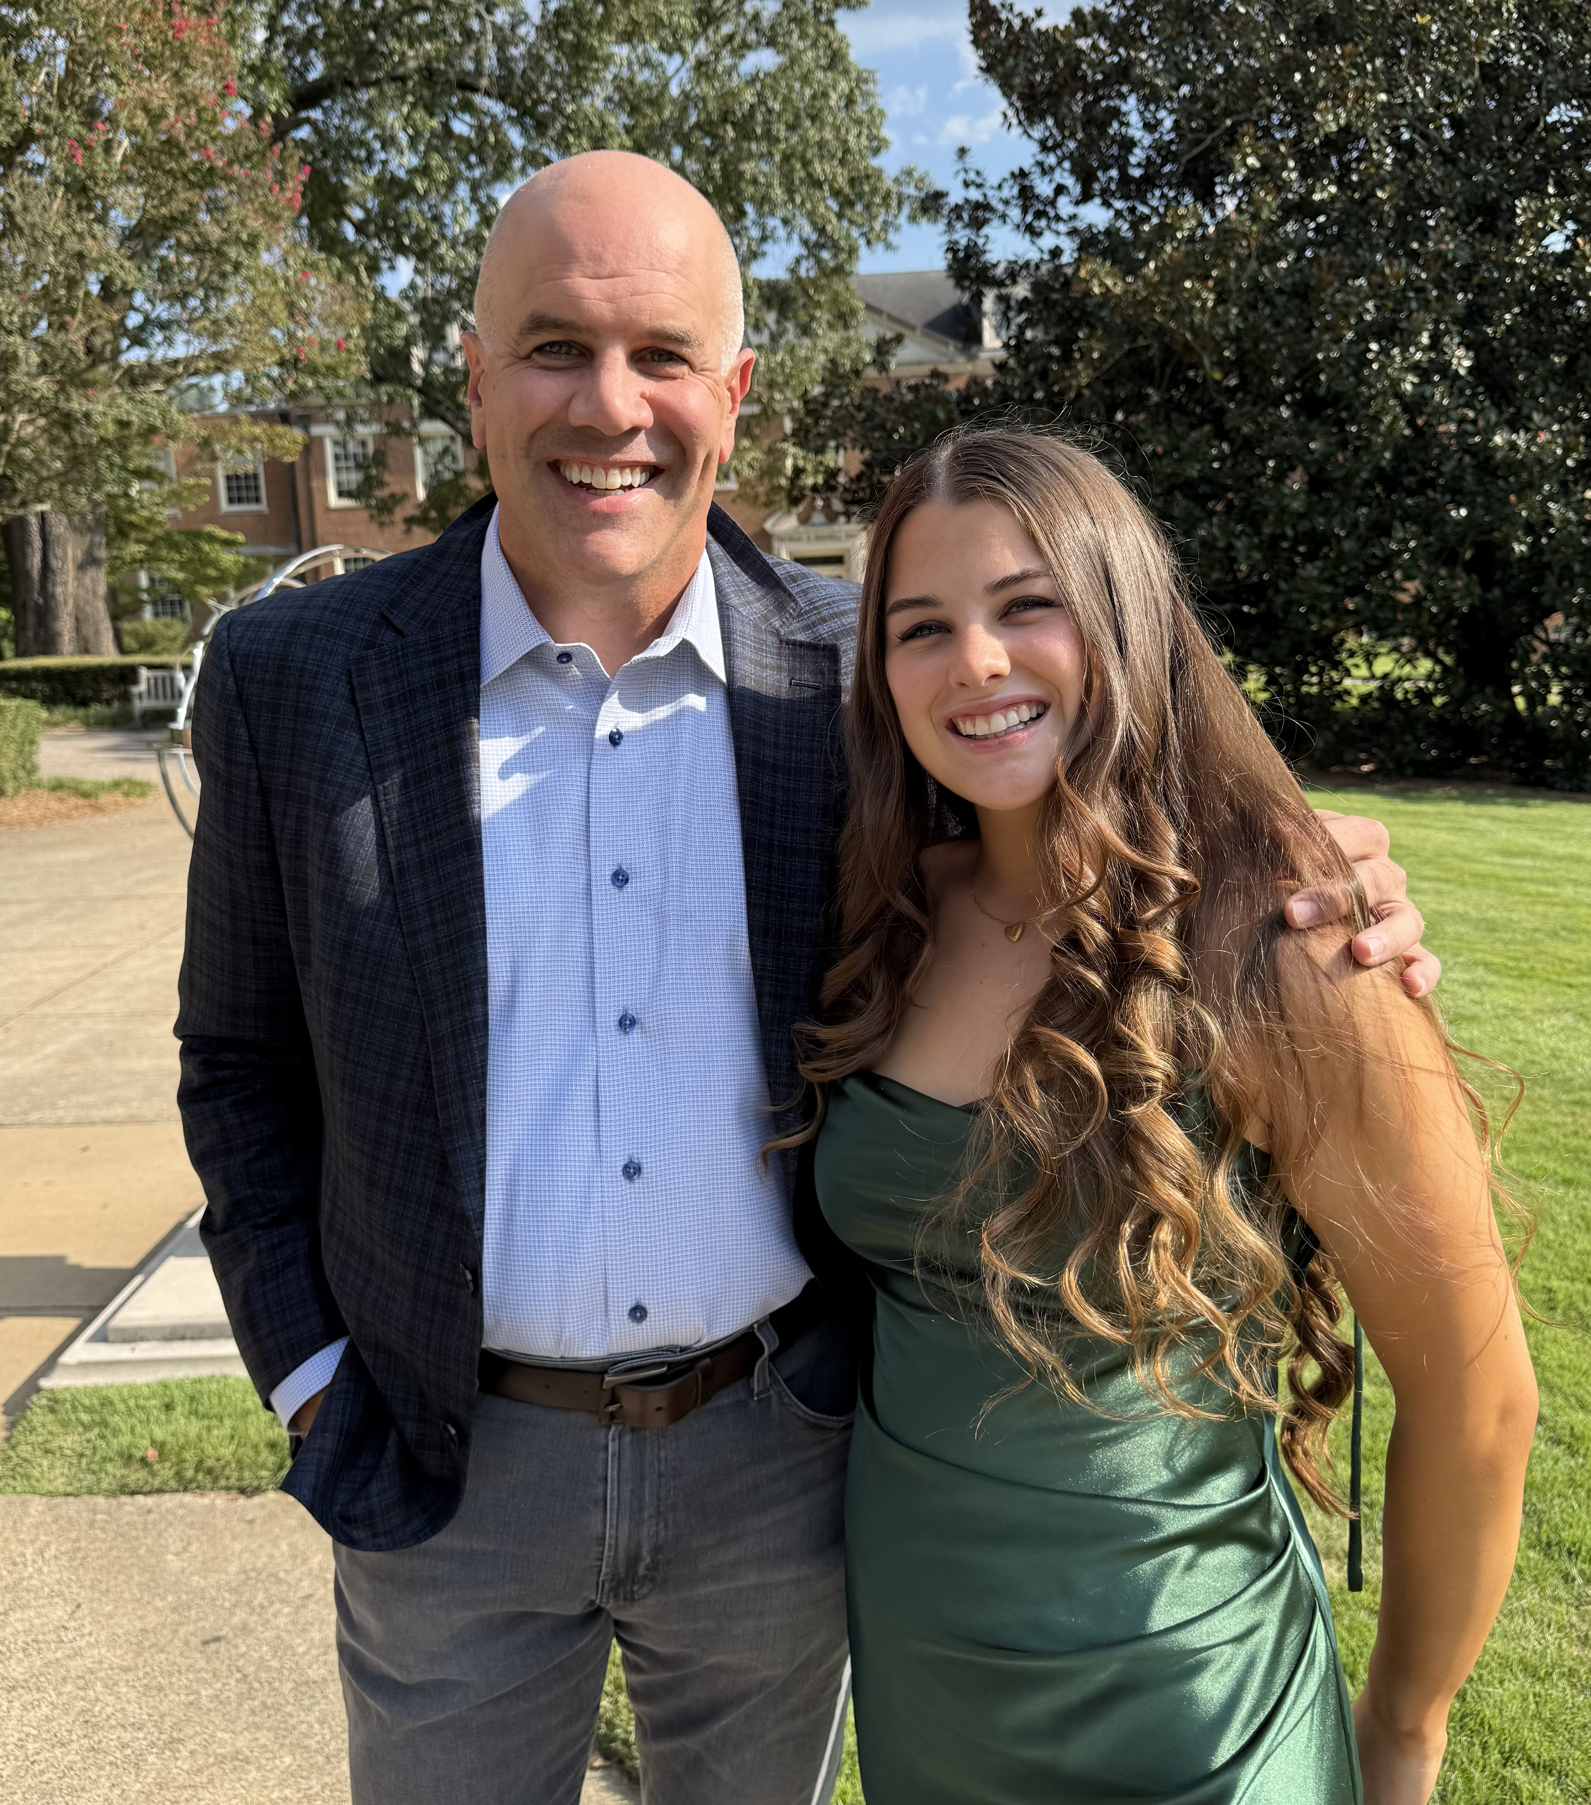

Slide 11
Listing Prices Have Already Flattened
Monthly Median Listing Price
Source: Realtor.com
Notes:
https://www.realtor.com/research/data/
https://www.realtor.com/research/august-2025-data-2/

Slide 12
Home Price Growth Is Moderating
Home Price Appreciation, Seasonally Adjusted, Year-Over-Year
Source: FHFA
Notes:
https://www.fhfa.gov/document/fhfa-house-price-index-report-2025q2
https://www.fhfa.gov/data/hpi/datasets?tab=monthly-data
https://www.mortgagenewsdaily.com/data/fhfa-home-prices

Slide 13
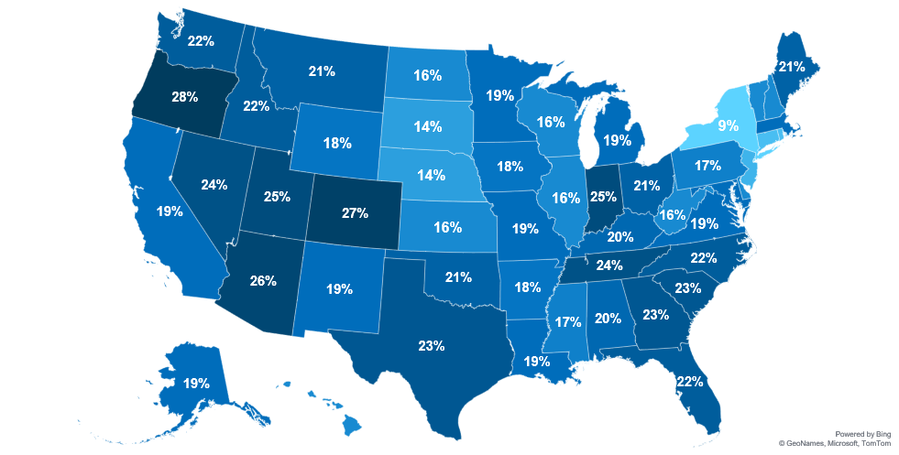
More Sellers Are Making Price Cuts
Share of Listings With a Price Reduction, August 2025
WA
MT
ND
NH 16%
ME
OR
MN
VT 16%
ID
SD
WI
NY
MA 19%
WY
MI
RI 11%
NE
IA
PA
CT 11%
NV
UT
IN
OH
NJ 12%
CA
IL
DE 16%
CO
KS
WV
VA
MD 19%
MO
KY
DC 14%
AZ
OK
TN
NC
NM
AR
SC
MS
AL
GA
TX
LA
AK
FL
HI
In August, 20.3%
of home listings
had price reductions.
16%
Source: Realtor.com
Notes:
https://www.realtor.com/research/data/
https://www.realtor.com/research/august-2025-data-2/

Slide 14
8 in 10 Potential Home Sellers Think They Will Get
Their Asking Price
or More
Source: Realtor.com
Notes:
https://www.realtor.com/research/2025-sellers-survey-btts/
Online survey conducted on March 9, 2025 – March 14, 2025 among n=801 homeowners who are thinking about selling their home in the next 12 months.

Slide 15
Home Price Trends Vary by Area
Year-Over-Year Change in Home Prices in 50 Largest Metros, August 2024 – August 2025
Source: ResiClub, Zillow
Notes:
https://www.resiclubanalytics.com/p/monthly-home-price-analysis-800-metros-3000-counties-25000-zips-september-2025-housing-market

Slide 16

The Fed,
Forecast,
and Future

Slide 17
The Last 5 Decades of Home Prices
Median Home Sales Price
Source: Census
Notes:
https://fred.stlouisfed.org/series/MSPUS
https://www.census.gov/construction/nrs/index.html

Slide 18
30-Year Fixed Mortgage Rate Projections
As of 9/17/2025
Quarter | Fannie Mae | MBA | Wells Fargo | Average of All 3
Q3 2025 | 6.70% | 6.70% | 6.40% | 6.60%
Q4 2025 | 6.50% | 6.60% | 6.30% | 6.47%
Q1 2026 | 6.40% | 6.50% | 6.20% | 6.37%
Q2 2026 | 6.20% | 6.50% | 6.20% | 6.30%
Notes:
https://img03.en25.com/Web/MortgageBankersAssociation/%7B5e377e4c-a183-4a98-8aac-2cf11b64651d%7D_Mortgage_Finance_Forecast_Aug_2025.pdf
https://wellsfargo.bluematrix.com/links2/html/140aa0d7-7733-4f58-9128-4a0cd9022f88#bm-img-9c703d27-719b-4a70-82c1-d9ecf7add344
https://www.fanniemae.com/media/56091/display

Slide 19
Mortgage Rates and Projections
30-Year Fixed Rate, as of 9/17/2025
Sources: Fannie Mae, MBA
Notes:
https://img03.en25.com/Web/MortgageBankersAssociation/%7B5e377e4c-a183-4a98-8aac-2cf11b64651d%7D_Mortgage_Finance_Forecast_Aug_2025.pdf
https://www.fanniemae.com/media/56091/display
https://wellsfargo.bluematrix.com/links2/html/140aa0d7-7733-4f58-9128-4a0cd9022f88#bm-img-9c703d27-719b-4a70-82c1-d9ecf7add344

Slide 20
For Over 50 Years, the 30-Year Mortgage Rate Has Moved in Unison with the 10-Year Treasury Yield
Average Spread: 1.76
Source: Macrotrends, Freddie Mac
Notes:
https://www.macrotrends.net/2016/10-year-treasury-bond-rate-yield-chart
https://www.freddiemac.com/pmms/pmms_archives

Slide 21
The Spread Has Narrowed Over the Past Couple Years
Average Spread 2.600
2.761
2.320
Sources: Freddie Mac, WSJ
Notes:
https://www.wsj.com/market-data/quotes/bond/BX/TMUBMUSD10Y/historical-prices
https://www.freddiemac.com/pmms

Slide 22
What Determines the Mortgage Rate?
The 10-Year Yield and the Spread Above It
MND Rate Survey 9.17.25: 6.13%
Sources: Mortgage News Daily, WSJ
Notes:
https://www.mortgagenewsdaily.com/
https://www.wsj.com/market-data/quotes/bond/BX/TMUBMUSD10Y?gaa_at=eafs&gaa_n=ASWzDAgcqmnno2vdeVD4KWGtNyOc82kFEIECwr4iSb62XB2TLnHH8iLm0X_H90CvPvE%3D&gaa_ts=68b88786&gaa_sig=fPjTWI8aVr6SQ-yt7JrG-VCXqU3jQNcJKB93LPKnP_g8Q5SSPZVyx9l0ro3s4xE9H2EuPNykNrQn7lt7UcW_ZQ%3D%3D

Slide 23
10-Year Treasury Forecast
As of 9/17/2025
Source: Forecasts.org
Notes:
https://www.forecasts.org/10yrT.htm

Slide 24
What If The Spread Was “Normal”?
The Increase in the Spread Above the 10-Year Yield
Mortgage Rate: 6.13%
Mortgage Rate: 5.79%
Sources: Mortgage News Daily, WSJ
Notes:
https://www.mortgagenewsdaily.com/
https://www.wsj.com/market-data/quotes/bond/BX/TMUBMUSD10Y/

Slide 25
With expectations growing for a rate cut at the Fed’s next meeting, this could be just the beginning of a stronger housing market heading into the fall.
Samir Dedhia
CEO, One Real Mortgage
Notes:
https://www.themortgagenote.org/average-rates-sink-to-6-5/

Slide 26
Lower Rates = Stronger Buyer Demand
Buyer Demand Based on the Average 30-Year Fixed Mortgage Rate
Buyer Demand
Weak
Limited
Good
Strong
Sources: Freddie Mac, Mortgage News Daily
Notes:
https://www.freddiemac.com/pmms/pmms_archives
https://www.mortgagenewsdaily.com/

Slide 27
2025 Home Price Forecasts
Percent Change as of 9/17/2025
Notes:
https://www.fanniemae.com/data-and-insights/surveys-indices/home-price-expectations-survey-hpes
https://www.fanniemae.com/media/56091/display
https://mediaroom.realtor.com/2025-07-23-Realtor-com-R-2025-Forecast-Update-Affordability-Crunch-Stalls-Market-Momentum
https://wellsfargo.bluematrix.com/docs/html/749540c1-a733-41a7-a33a-7c78dbfca2be.html
https://img03.en25.com/Web/MortgageBankersAssociation/%7B5e377e4c-a183-4a98-8aac-2cf11b64651d%7D_Mortgage_Finance_Forecast_Aug_2025.pdf
https://cms.nar.realtor/sites/default/files/2025-07/2025-07-real-estate-forecast-summit-real-estate-and-economic-outlook-lawrence-yun-presentation-slides-07-16-2025.pdf?
https://www.zillow.com/research/home-value-sales-forecast-33822/

Slide 28
Estimated Home Price Appreciation
Forecast in Q2 2025
Source: Fannie Mae
Notes:
https://pulsenomics.com/surveys/#home-price-expectations
https://www.fanniemae.com/data-and-insights/surveys-indices/home-price-expectations-survey-hpes

Slide 29
U.S. Home Price Expectations
Fannie Mae Home Price Index Mean Expectations, Q2 2025-Q4 2029
27.4%
Expected Cumulative Home Price
% Change
2025-2029
17.6%
6.7%
Source: Fannie Mae
Notes:
https://www.fanniemae.com/data-and-insights/surveys-indices/home-price-expectations-survey-hpes

Slide 30
Home Sales Are Expected To Rise
Total Home Sales (Forecasts as of 9/17/2025)
Source: Fannie Mae, MBA, NAR
Notes:
https://www.fanniemae.com/media/56091/display
https://img03.en25.com/Web/MortgageBankersAssociation/%7B5e377e4c-a183-4a98-8aac-2cf11b64651d%7D_Mortgage_Finance_Forecast_Aug_2025.pdf
https://cms.nar.realtor/sites/default/files/2025-07/2025-07-real-estate-forecast-summit-real-estate-and-economic-outlook-lawrence-yun-presentation-slides-07-16-2025.pdf?_gl=1*1dut8bl*_gcl_au*MTg4NDE2ODkwOC4xNzUzOTA1MDc2

Slide 31
. . . home value appreciation has slowed to a standstill. Typical home value growth nationwide measured by Zillow's Home Value Index is now flat over the past year — the second-slowest annual growth of any month since the start of 2018.
Zillow
Notes:
https://zillow.mediaroom.com/2025-09-16-Sellers-slam-the-brakes-new-listings-fall-to-record-low-for-August

Slide 32
81% of Mortgages Have a Rate Under 6%
Mortgage Rate on All Mortgages (Values Weighted by Number of Loans), Q1 2025
Source: FHFA
Notes:
https://www.fhfa.gov/data/dashboard/nmdb-outstanding-residential-mortgage-statistics

Slide 33
49 36 14

Slide 34
Home Value, Equity, and Debt
In Trillions
Source: St. Louis Fed
Notes:
https://fred.stlouisfed.org/tags/series?t=real+estate

