Slide 1

Chat GPT for Realtors: From Busywork to Bookings
Save hours on copy, follow-up, and prep—so you can spend more time with clients.

Slide 2
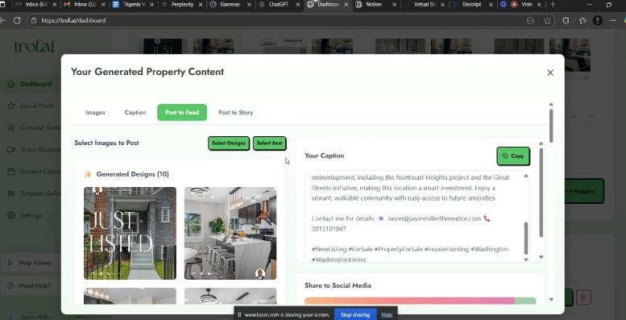

Slide 3


Why This Matters
Agents Are Drowning in Admin Tasks
Writing property descriptions, crafting follow-up emails, preparing client notes, and managing endless paperwork consume precious hours that should be spent with clients.
AI Provides the Ultimate Leverage
Artificial intelligence transforms how you work: faster writing, smarter systems, and consistent follow-up processes that scale your business without burning you out.
Today's agenda: Setup → prompting (STACK) → LLMs → build 2 GPTs → Gamma presentations → bonus tools → join the community

Slide 4


Set Up Your ChatGPT Profile
Personalization is Key
Give it your name, market area, and niche specialty
Define your unique brand voice and communication style
Specify important constraints like fair housing compliance and MLS safety rules
Save your profile as a pinned "System" message for consistency
Starter Profile Example: "You are Jason Miller's AI assistant—DMV realtor. Match my tone: confident, clear, helpful. Follow fair housing and MLS safety rules. Always ask 3 clarifying questions before drafting content."

Slide 5
The S.T.A.C.K. Method
Your reliable framework for AI prompting that works across all platforms
Set the Role
Tell the Need
Add Context
Define who the AI should be: luxury listing agent, buyer specialist, market analyst
Clearly state what you want: property description, follow-up email, market report
Provide specific details: property features, client situation, market conditions
Choose Output
Keep It Going
Specify format and length: 200-word description, 3 bullet points, email subject line
Refine and iterate: ask for variations, different tones, or additional formats
This method works seamlessly in ChatGPT, Claude, Gemini, and Perplexity. Live demo coming up!

Slide 6

LLMs You Should Know
Choose the right AI tool for each specific task to maximize your efficiency
ChatGPT
Claude
Best for: Balanced writing, custom GPTs, and integrated tools. Excellent for property descriptions and client communications.
Best for: Processing long documents and maintaining a professional, cautious tone. Perfect for contract reviews and detailed market analyses.
Gemini
Perplexity
Best for: Google workspace integration and real-time data. Ideal for market research and Google Sheets automation.
Best for: Fast research with live citations and current market data. Essential for competitive market analyses and trend reports.
Pro Tip: Use the right tool for the task, not one tool for everything. This strategic approach will dramatically improve your results.

Slide 7
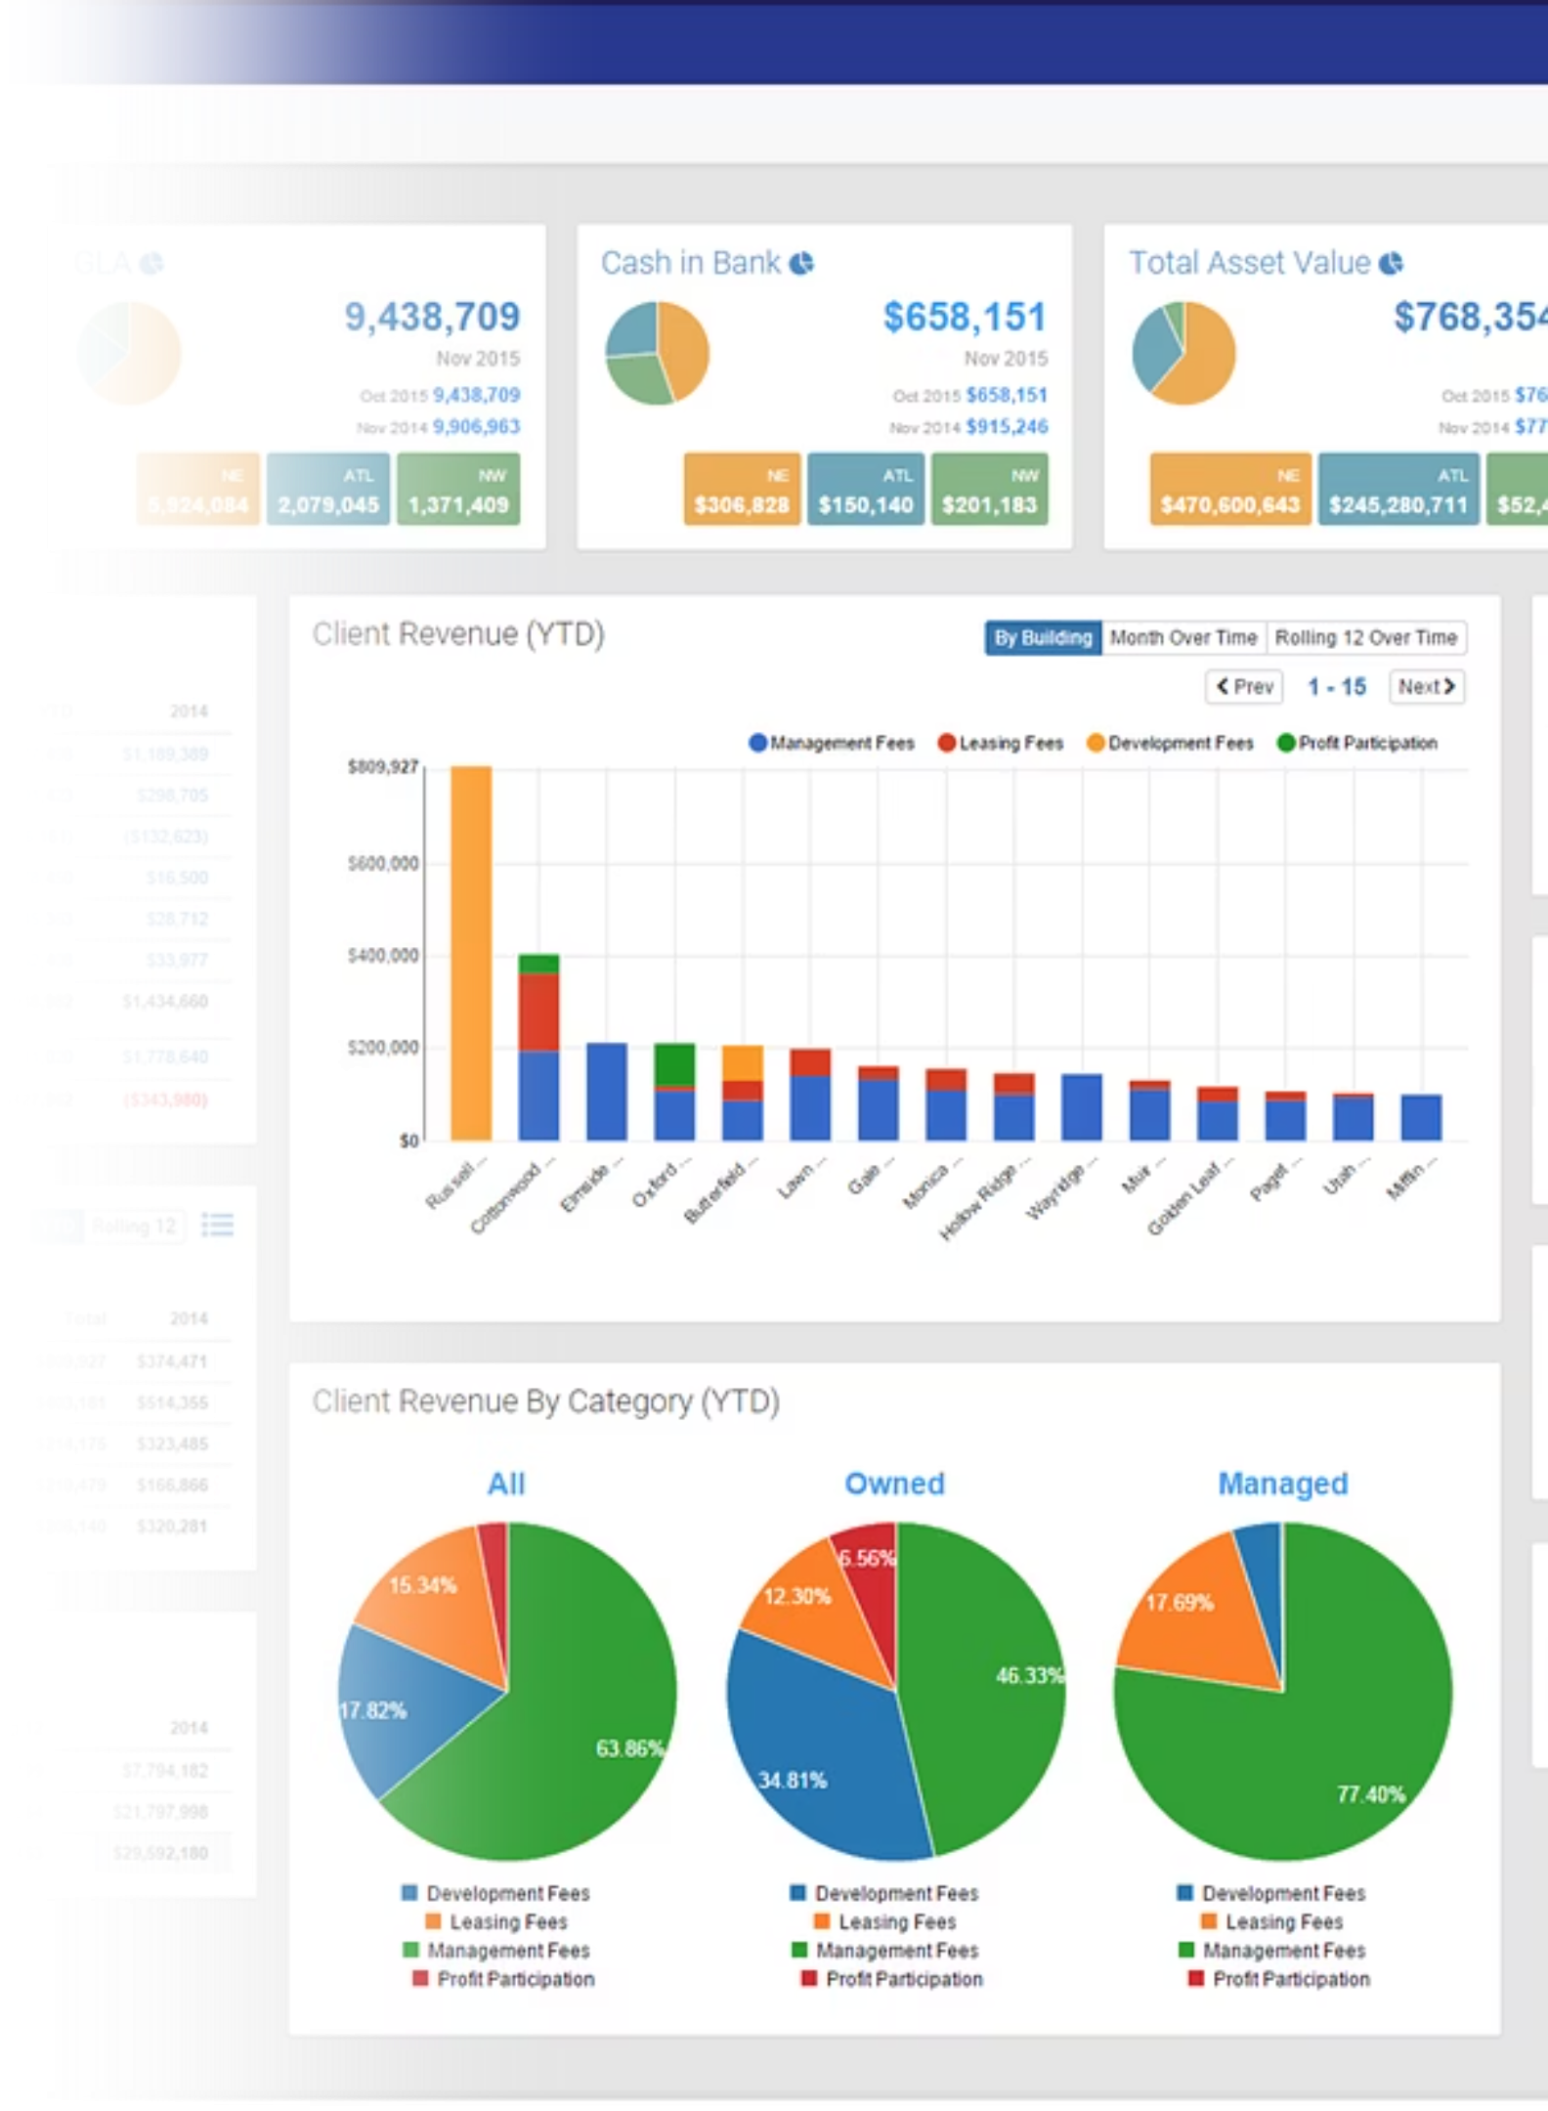
Research Warm-Up with Perplexity
Master Market Intelligence
Discover top agent content strategies and optimal posting schedules for your market
Extract proven, repeatable patterns that align with your brand voice and target audience
Build a library of research templates you can reuse for different neighborhoods and property types
We'll walk through creating your first research prompt and saving it as a reusable template that keeps you ahead of market trends.

Slide 8

Sell Strategy — 8729 Ritchboro Rd
District Heights, MD • Prepared by Jason Miller, Samson Properties
Strategic pricing and preparation recommendations to maximize your sale

Slide 9


Property Snapshot
Home Features
3 bedrooms, 1.5 bathrooms
2-level home with finished basement
1,200+ finished square feet
0.25 acre lot with mature landscaping
Location Highlights
Established District Heights neighborhood
Close to shopping and transit
No HOA fees
Built 1960s with original hardwood floors
Property shows well but may benefit from cosmetic updates to compete with recently renovated comparables

Slide 10
Recent Closed Sales Analysis
Comparable sales within 0.5 miles over the past 6 months:
Address
Close Date
List Price
Sale Price
$/SF
BR/BA
DOM
8735 Ritchboro Rd
Dec 2024
$285,000
$275,000
$198
3/1.5
45
8721 Ritchboro Rd
Nov 2024
$295,000
$290,000
$208
3/2
28
8810 Allendale Dr
Oct 2024
$270,000
$265,000
$185
3/1
52
8603 Darcy Rd
Sep 2024
$305,000
$298,000
$215
4/2
22
Average sale price: $282,000 | Average $/SF: $202 | Average DOM: 37 days

Slide 11
Current Market Competition
Active listings and pending sales in your immediate area:
Address
Status
List Price
$/SF
DOM
Key Difference
8742 Ritchboro Rd
Active
$289,000
$205
18
Recently renovated
8655 Darcy Rd
Pending
$275,000
$192
12
As-is condition
8825 Allendale Dr
Active
$299,000
$218
31
Extra bedroom
Your main competition includes both move-in ready and fixer-upper properties

Slide 12



Strategic Pricing Recommendations
Conservative
Market Value
Optimistic
$270,000
$280,000
$290,000
Quick sale strategy
Balanced approach
Test market ceiling
Expected DOM: 15-25 days
Expected DOM: 25-40 days
Expected DOM: 45-60 days
01
02
03
Launch Strategy
10-Day Checkpoint
21-Day Review
Start at market value to generate initial activity
Evaluate showing activity and feedback
Consider $5-10K reduction if limited interest

Slide 13

Investment vs. Return Analysis
Four preparation scenarios to maximize your net proceeds:
Budget
Scope Highlights
Expected Sale Range
Net Benefit
$0 (As-Is)
List current condition
$270,000-$280,000
Baseline
$10,000-$15,000
Paint, deep clean, minor repairs
$275,000-$285,000
+$5,000-$10,000
$25,000-$35,000
Kitchen refresh, bathroom updates, flooring
$285,000-$295,000
+$10,000-$15,000
$50,000-$60,000
Full kitchen/bath remodel, HVAC, roof
$295,000-$310,000
+$5,000-$15,000
Recommended: Light to mid-level improvements provide the best return on investment for this market segment

Slide 14
Estimated Net Proceeds
Your estimated proceeds at different price points and commission structures:
5% Commission Structure
6% Commission Structure
Item
Conservative
Market
Optimistic
Item
Conservative
Market
Optimistic
Sale Price
$270,000
$280,000
$290,000
Sale Price
$270,000
$280,000
$290,000
Commission (5%)
$13,500
$14,000
$14,500
Commission (6%)
$16,200
$16,800
$17,400
Transfer Tax
$1,485
$1,540
$1,595
Transfer Tax
$1,485
$1,540
$1,595
Title/Settlement
$1,200
$1,200
$1,200
Title/Settlement
$1,200
$1,200
$1,200
Net to Seller
$253,815
$263,260
$272,705
Net to Seller
$251,115
$260,460
$269,805

Slide 15

Preparation Timeline & Action Plan
Week 1-2: Prep Phase
Week 4: Market Launch
Complete agreed-upon improvements
MLS listing activation
Deep cleaning and decluttering
Portal syndication
Address punch-list items
Agent outreach begins
Coordinate vendor scheduling
First showings scheduled
1
2
3
4
Week 3: Media Production
Week 5-8: Active Marketing
Professional photography
Open houses
Virtual tour creation
Buyer agent feedback
Drone exterior shots
Weekly market updates
Marketing material preparation
Strategy adjustments

Slide 16




Comprehensive Marketing Strategy
Digital Marketing
BRIGHT MLS syndication
Zillow, Realtor.com featured listing
Social media campaigns
Email to 500+ buyer agents
Traditional Marketing
Weekend open houses
Professional yard signage
Neighbor notification campaign
Print advertising in local publications
Service Standards
48-hour showing availability
Same-day feedback collection
Weekly progress reports
Proactive communication
Maryland Compliance: All required disclosures, lead paint notifications (pre-1978), and smoke/CO detector certifications will be handled professionally

Slide 17

Recommended Strategy & Next Steps
My Recommendation
Light improvement package ($10-15K) with $280,000 list price
Best balance of investment return and market positioning
Projected net proceeds: $248,000-$258,000
01
02
Finalize Improvement Scope
Set Listing Price
Review and approve specific renovation items and budget
Confirm launch price based on final property condition
03
04
Execute Listing Agreement
Schedule Media Production
Sign listing documents and disclosure forms
Book photography and begin marketing material creation
Ready to move forward? Let's discuss any questions and finalize our strategy.

Slide 18
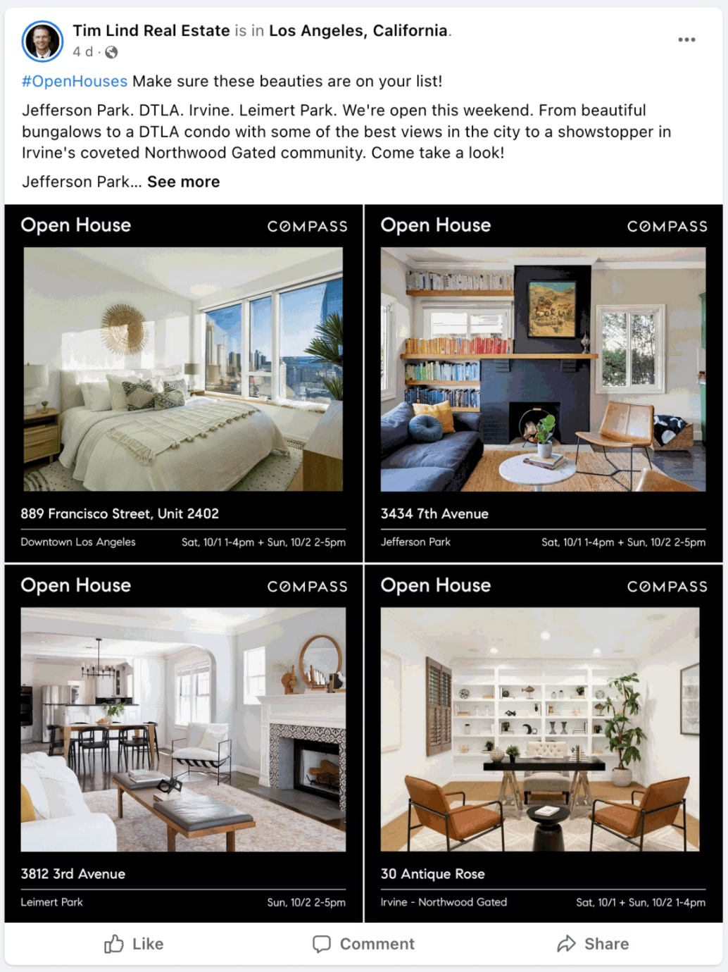

Build GPT #1: Listing & Social Copy Pro
Your Personal Copywriting Assistant
Role: Luxury DMV listing copywriter + social media strategist
Inputs: MLS data points, property features, neighborhood updates, market insights
Outputs: MLS-compliant descriptions (2 lengths), Instagram captions, 5 targeted SEO hashtags
Smart Constraints: Fair housing compliance, MLS rules, always asks 3 clarifying questions before drafting
This GPT will transform raw property data into compelling marketing copy that drives engagement and inquiries while staying compliant with all regulations.

Slide 19

Build GPT #2: Realtor Call Lab
01
Role-Play Different Personalities
Practice with skeptical buyers, motivated sellers, FSBO owners, and expired listing prospects
02
Perfect Your Scripts
Generate 20-second voicemails, 160-character text messages, and 120-word follow-up emails
03
Handle Objections Like a Pro
Practice responses to price concerns, timing issues, agent loyalty questions, and commission discussions
04
Build Your Objection Library
Track common objections and save your most effective responses for future use

Slide 20





Gamma: Presentations That Win Listings
Create unique, personalized seller and buyer presentations that stand out from generic MLS templates.
Start with Property Data
Gather MLS information, neighborhood insights, and market comparables
Enhance with AI Content
Use ChatGPT/Claude for compelling copy and Perplexity for market research
Design in Gamma
Transform your content into a professional presentation that impresses clients
Export and Present
Generate a polished PDF ready for client meetings or email delivery

Slide 21
Live Demo Plan
Watch the complete workflow in action—from research to finished presentation
Perplexity Research
1
Quick market check and competitor analysis
2
ChatGPT STACK Method
Transform raw data using our proven framework
Content Generation
3
Create compelling copy and marketing materials
4
Gamma Design
Build professional presentation template
PDF Export
5
Final polished deliverable ready for clients

Slide 22



Bonus Tools for Maximum Impact
Otter & Fireflies
Collav.AI
Trof.AI
Transform meeting recordings into detailed CRM notes and action items automatically. Never miss important client details again.
Access content helpers and proven templates through our affiliate partnership. Streamline your marketing workflow with ready-made solutions.
Social Post Builder
Generate engaging social media content in minutes with our affiliate tool. Includes special discount codes for attendees.
Links and exclusive discount codes will be shared in the community group!

Slide 23
Your First 7 Days Action Plan
Monday: Foundation
1
Set up your ChatGPT profile with personalized prompts and constraints
2
Tuesday: Build Tools
Create your first GPT for listing and social copy generation
Wednesday: Follow-Up System
3
Develop open house follow-up email templates using AI assistance
4
Thursday: Meeting Notes
Record and transcribe one client consultation with Otter or Fireflies
Friday: Presentation Power
5
Publish your first Gamma seller presentation deck
6
Weekend: Content Creation
Create 2 short-form videos and 1 long-form content piece using AI tools

Slide 24


Join Our Exclusive Community
Rova.ai Private Network
Connect with like-minded real estate professionals who are leveraging AI to transform their businesses.
Private Facebook Group: Share wins, ask questions, get feedback from peers
Rova.ai Platform: Access lead nurture templates, automation workflows, and training replays
Exclusive Resources: Get the complete STACK Prompt Pack and custom GPT templates
Ongoing Support: Weekly office hours and new tool updates
Scan the QR code or use the short link to join immediately and start accessing member-only resources.

Slide 25

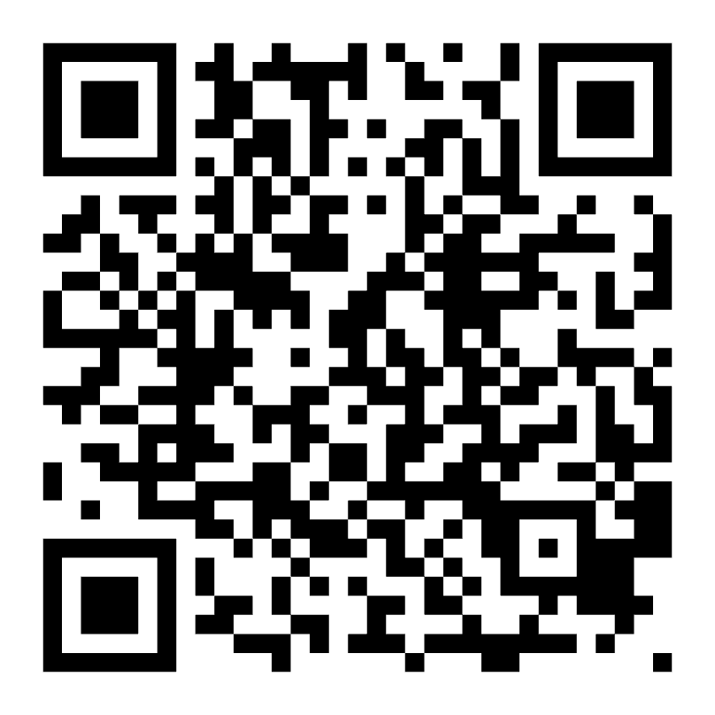
Join Collov AI with My Affiliate Link
Virtual staging made simple with AI.
Recommended by Jason Miller, Realtor & AI Coach.
Scan the code to transform your listings.

Slide 26


Join Trof AI with My Affiliate Link
AI-powered social media posts and automation.
Use affiliate code:
Jmiller1
for 10% discount.

Slide 27
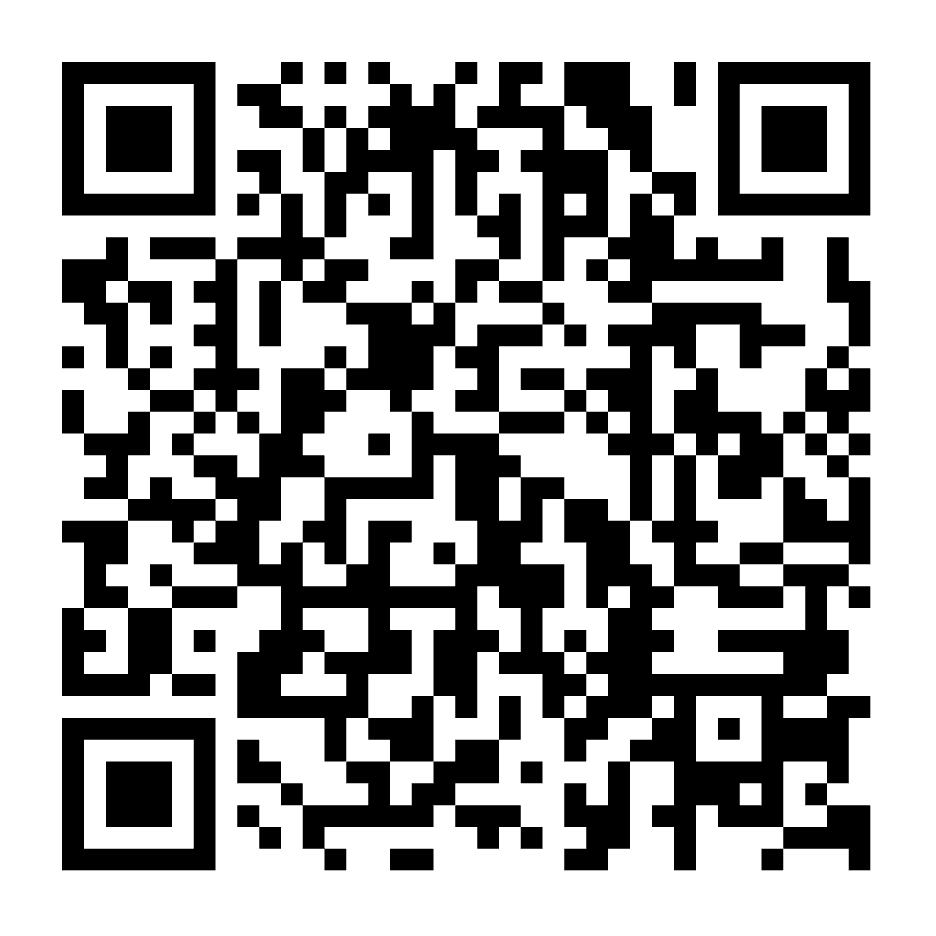

Join the ROVA AI Facebook Community
Learn AI + automation for Realtors.
Connect with a growing network of real estate professionals dedicated to mastering AI and transforming their business.
Free group, join the movement.
Scan to join our exclusive community

Slide 28

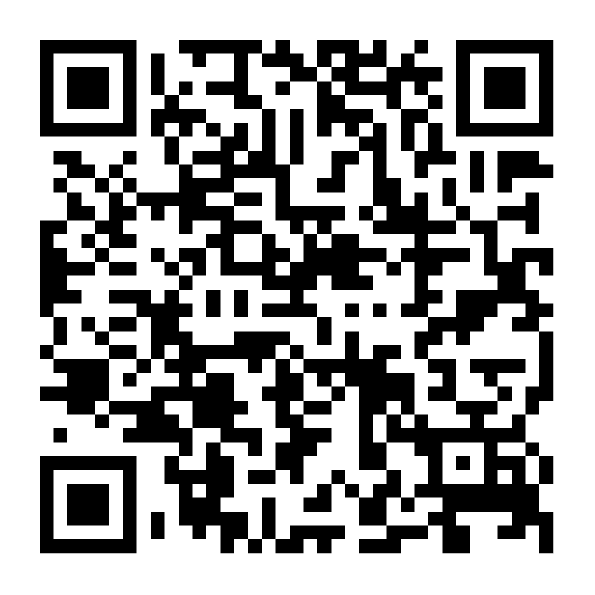
Join the ROVA AI Automation Waitlist
Done-for-you AI CRM, lead nurture, and automation system.
Future-Proof Your Business
Be among the first to experience a revolutionary AI system designed exclusively for real estate professionals.
Automate lead follow-up and engagement.
Streamline client communications.
Optimize your CRM for maximum efficiency.
Unlock unparalleled productivity.
Scan to get on the waitlist today!

Slide 29

Q&A & Next Steps
What's one AI Tool you'll implement this week?
Stay Connected
Take Action Today
Follow @just_jasonmiller on Instagram for daily AI tips and real estate insights.
Join the Rova.ai community
Set up your ChatGPT profile
Email: jason@jasonmillertherealtor.com
Schedule your first AI workflow
Phone: 301-310-1847
Connect with fellow agents
Transform your real estate business with AI. The future of efficient, profitable real estate is here.

